Slide 1
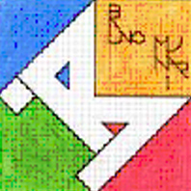
“COME WITH US” eTwinning PROJECT
TOPIC 6: ART
CLASSE V B - ANGELO MAURI

Slide 2
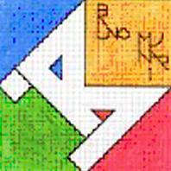
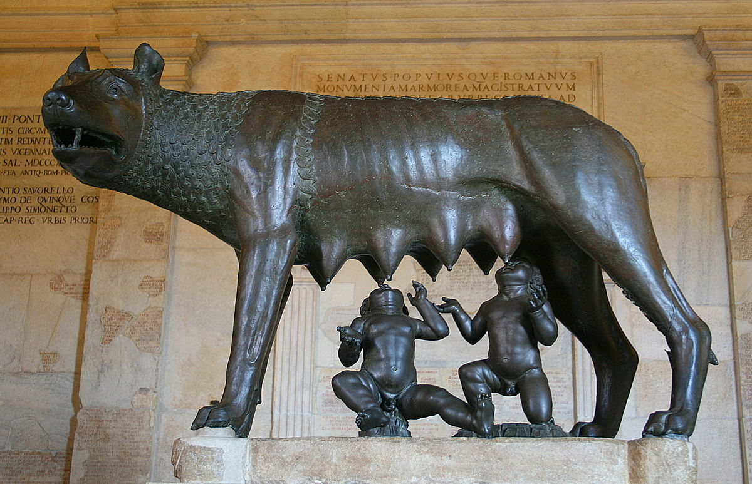
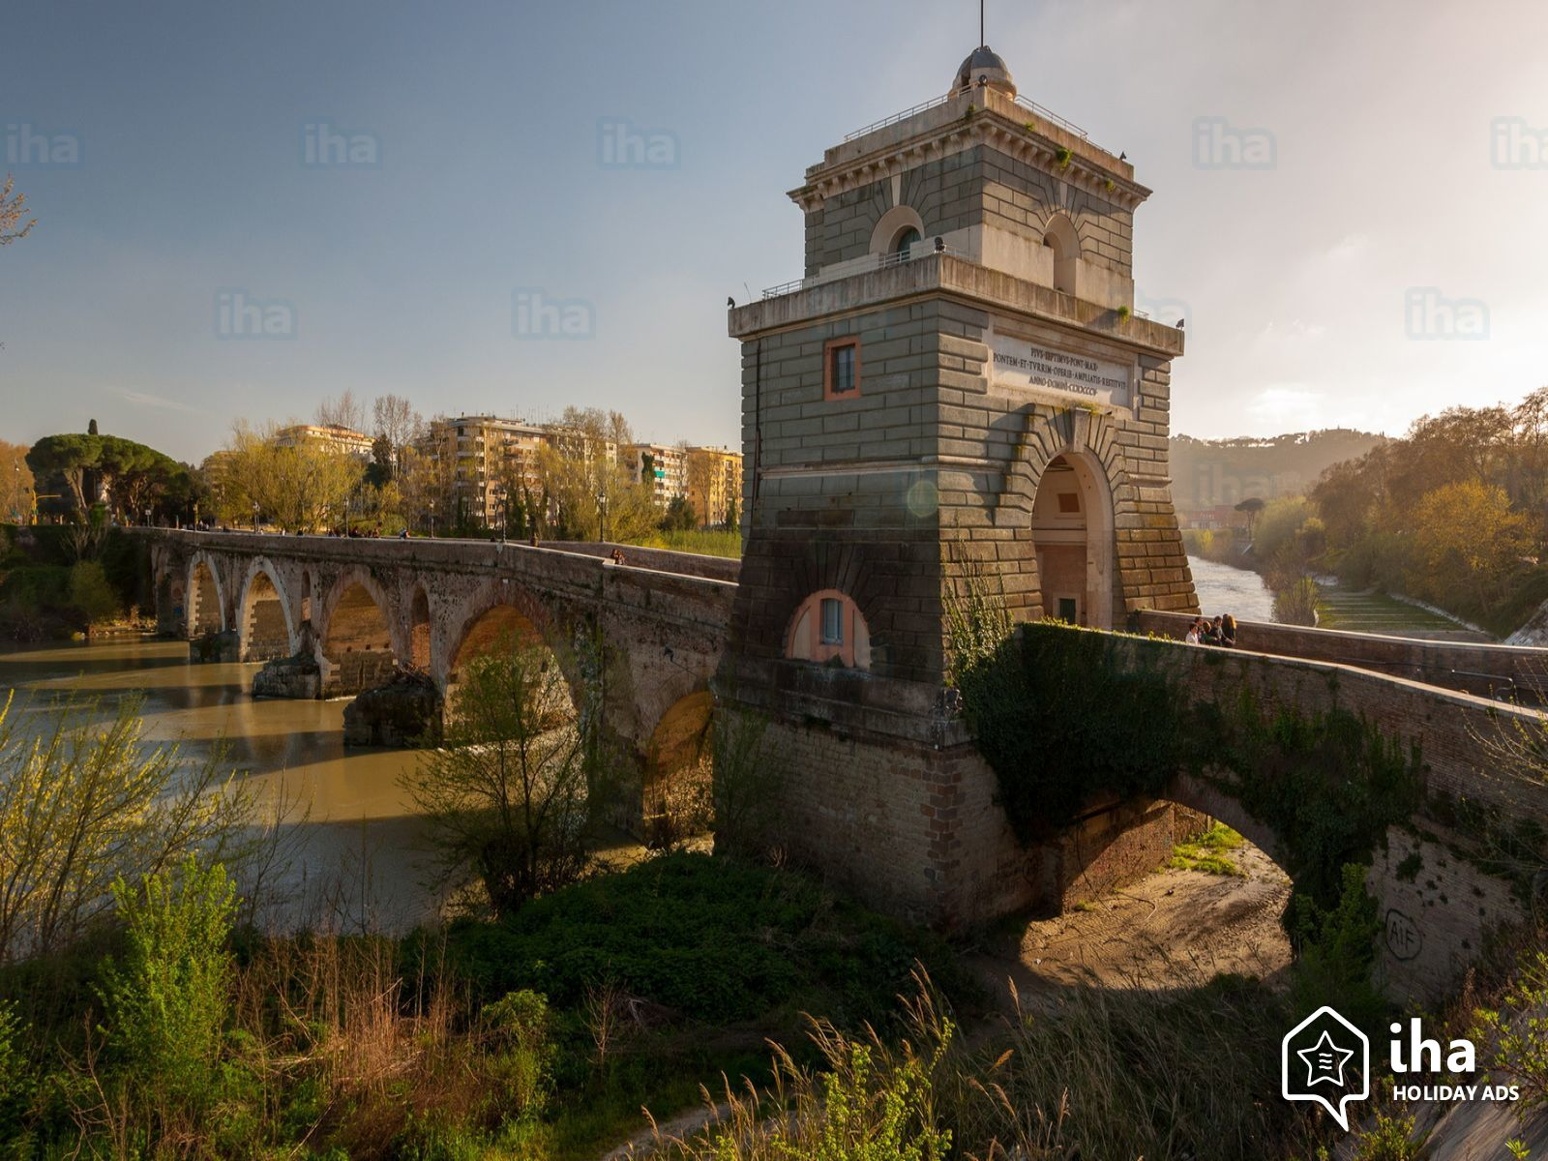
Art in Rome
Latins found Rome in 753 B.C.
The legend tells that a she-wolf finds twins,
Romolus and Remus,
on the banks of river Tiber and nurses them.
Romolus founds the city of Rome.
Capitoline she-wolf and the twins
The Tiber river under Milvio bridge or Ponte Mollo

Slide 3
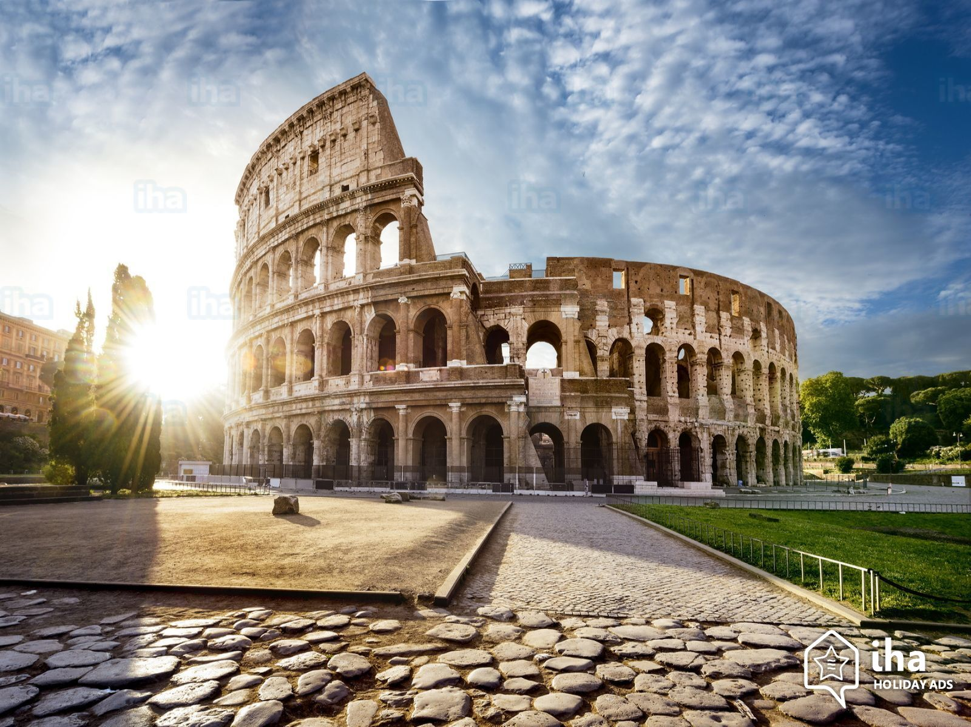
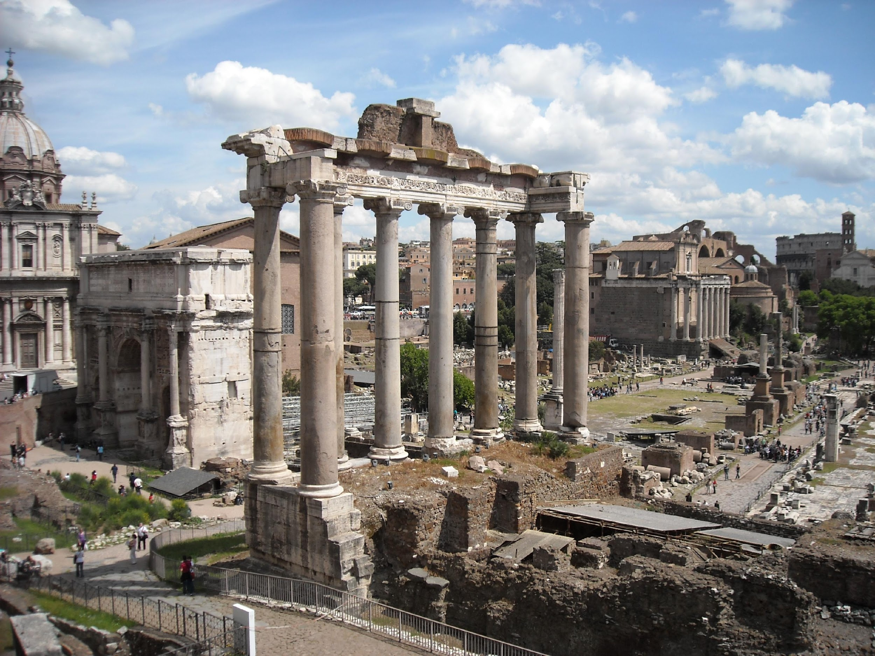
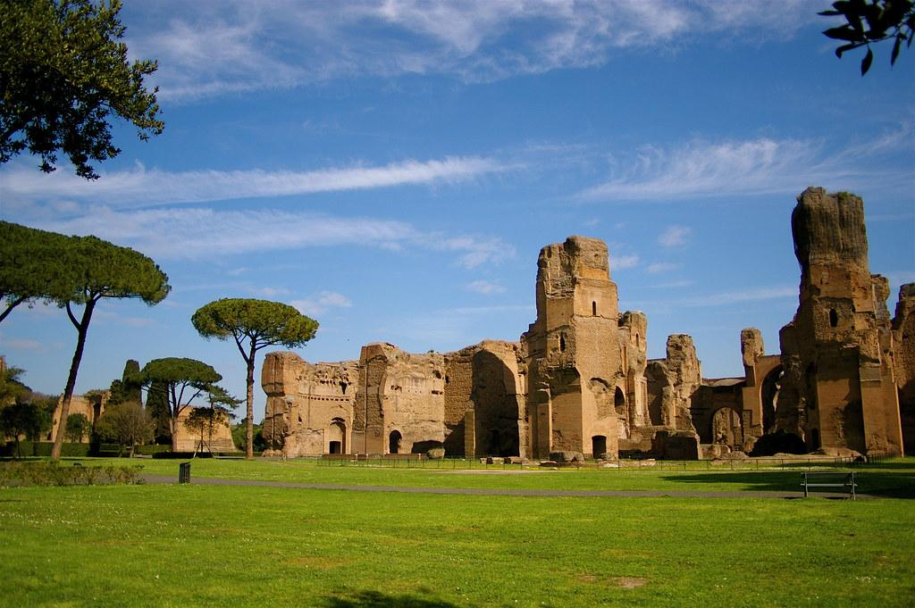
The Roman Foro
Caracalla’s baths
The Colosseum
Rome is the cradle of western world.
Art was born in Roman times...

Slide 4
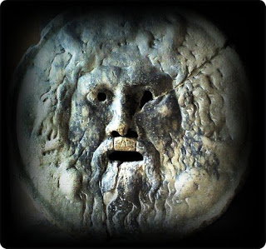
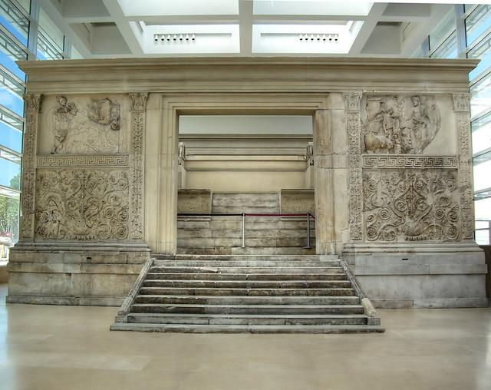
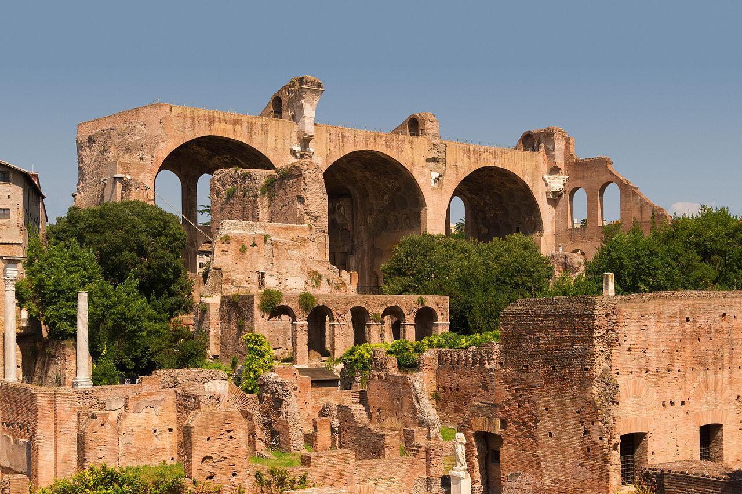
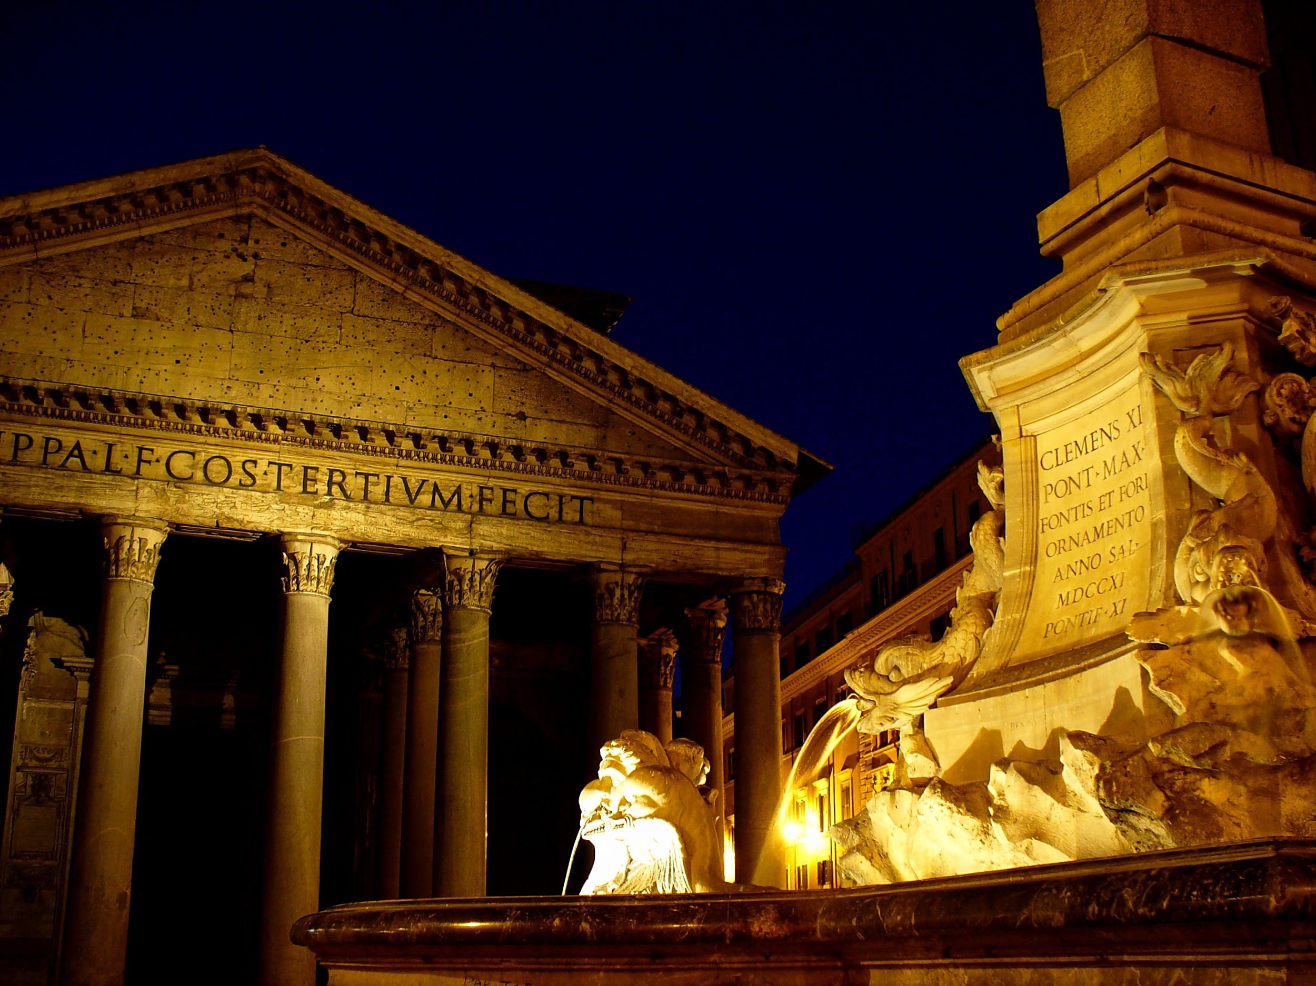
Mouth of Truth
Ara Pacis
Pantheon originally dedicated to Rome’s Pagan gods
Basilica of Maxentius

Slide 5
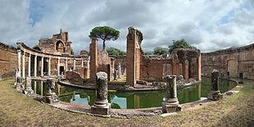
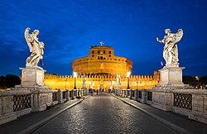
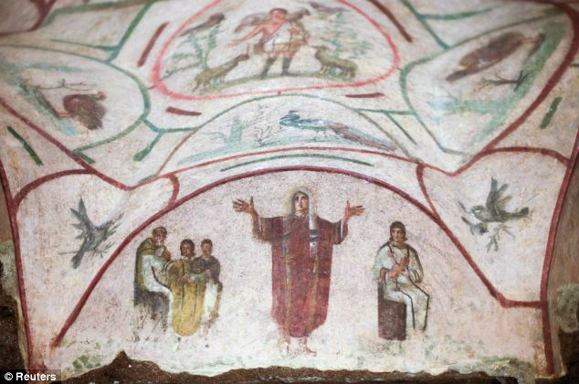
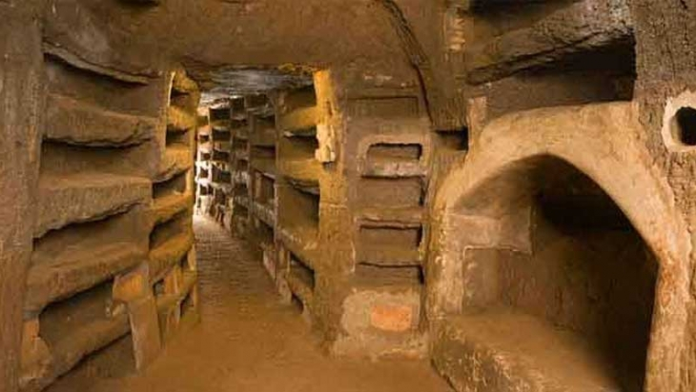
Villa of Emperor Hadrian
Castel Sant’Angelo or Hadrian’s Mausoleum
Paintings in the catacomb of St. Priscilla
Catacombs of St. Priscilla in Via Salaria
… then by the Romans to the art of the first Christians

Slide 6
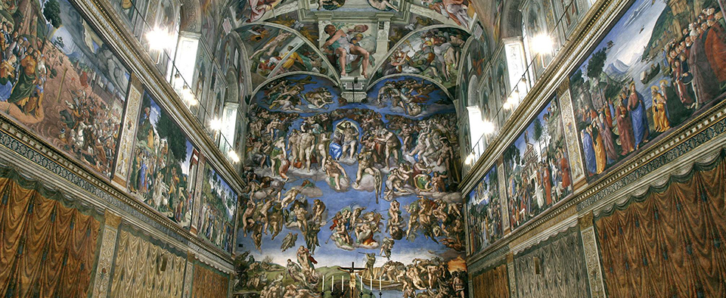
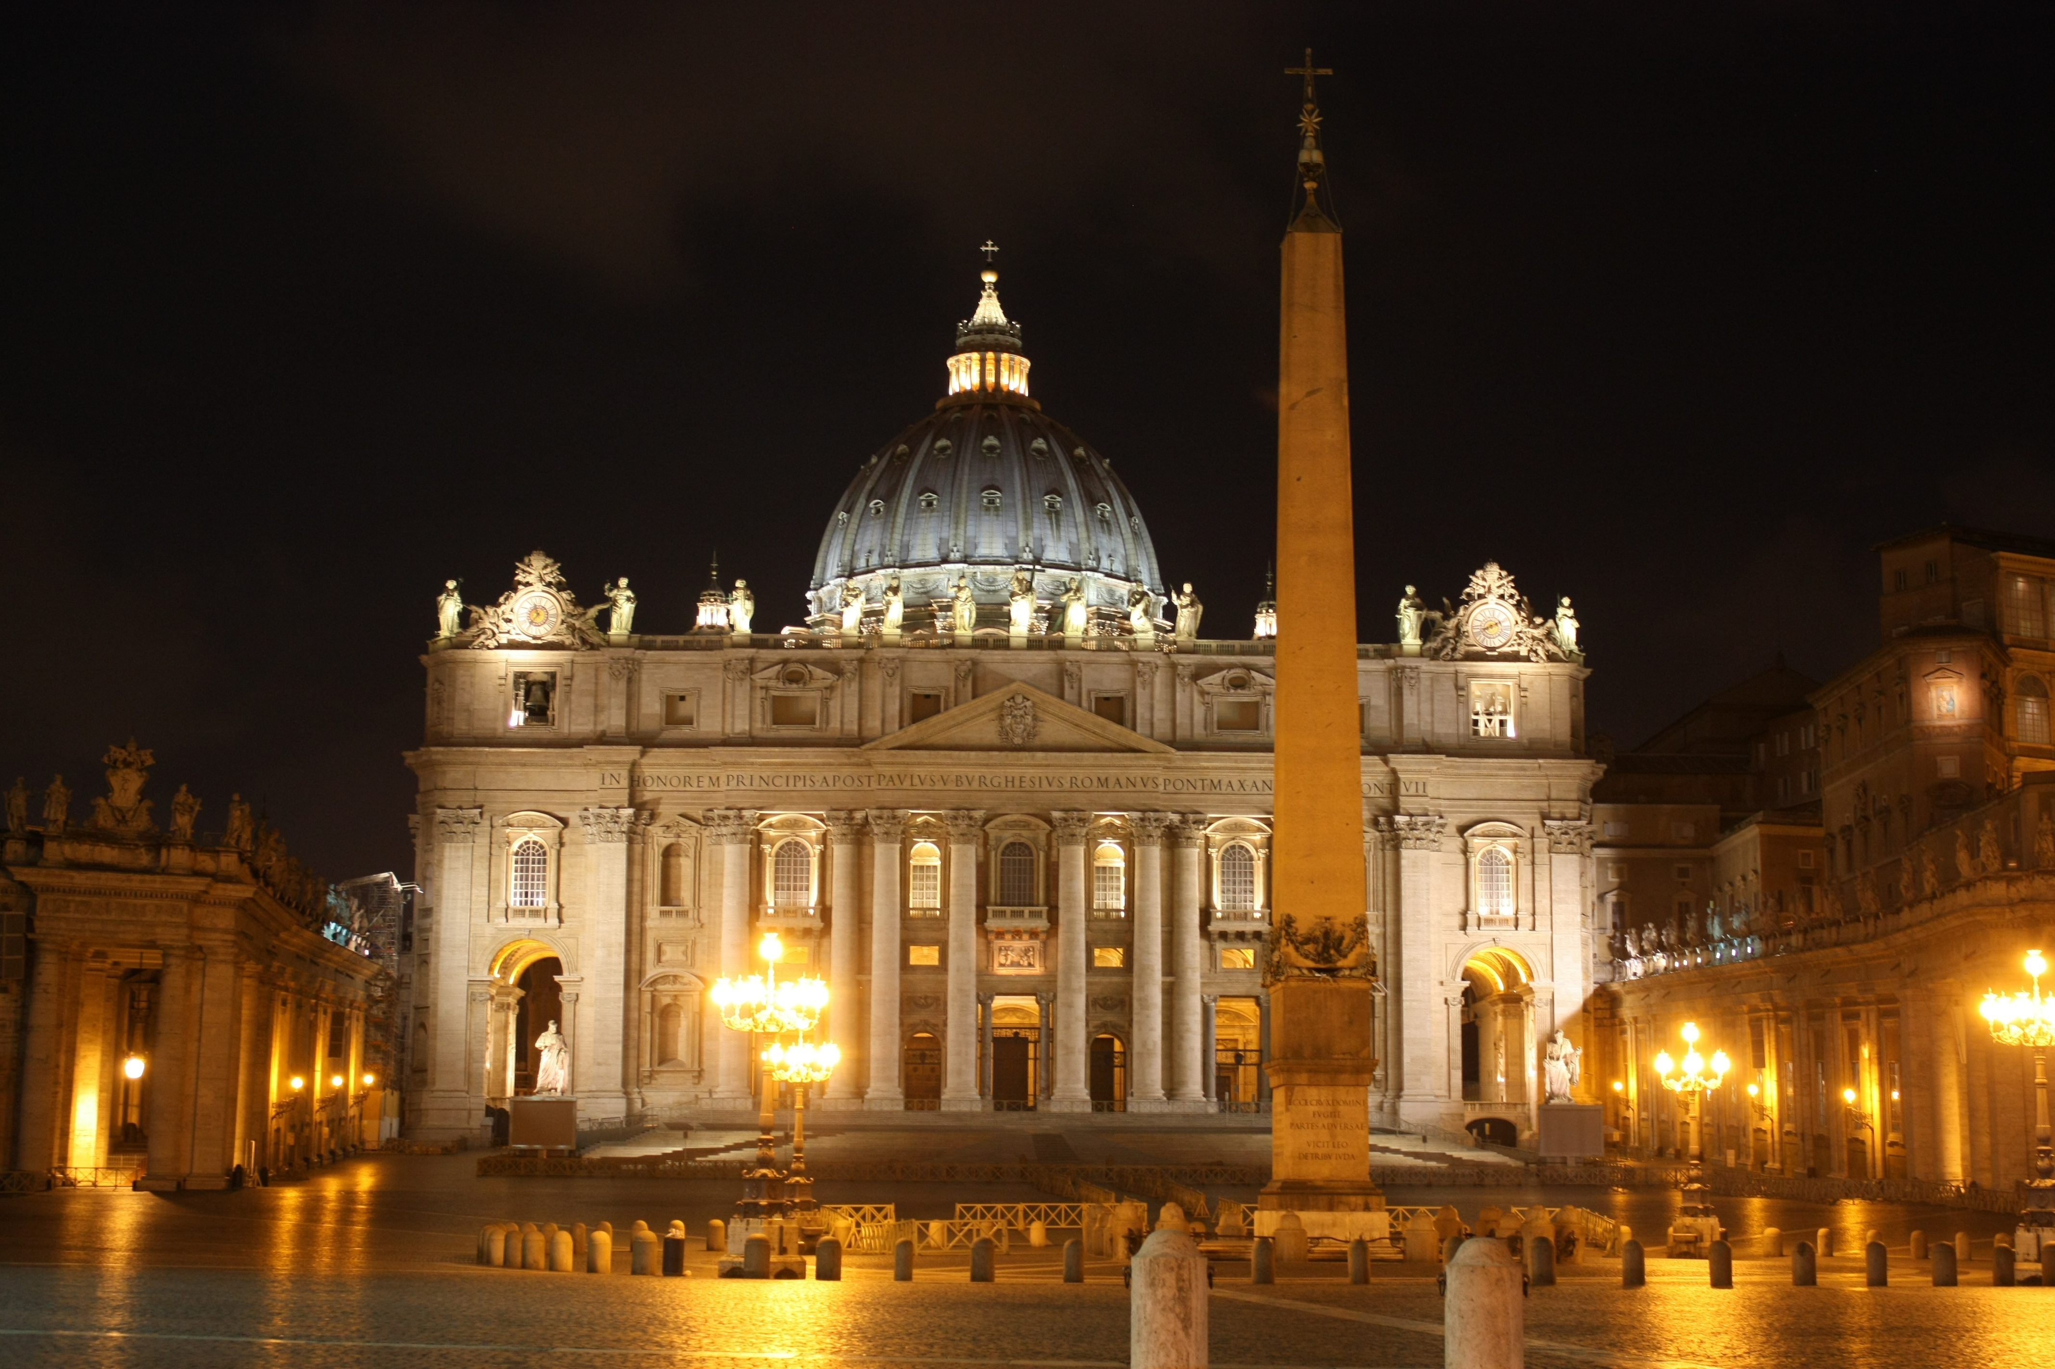
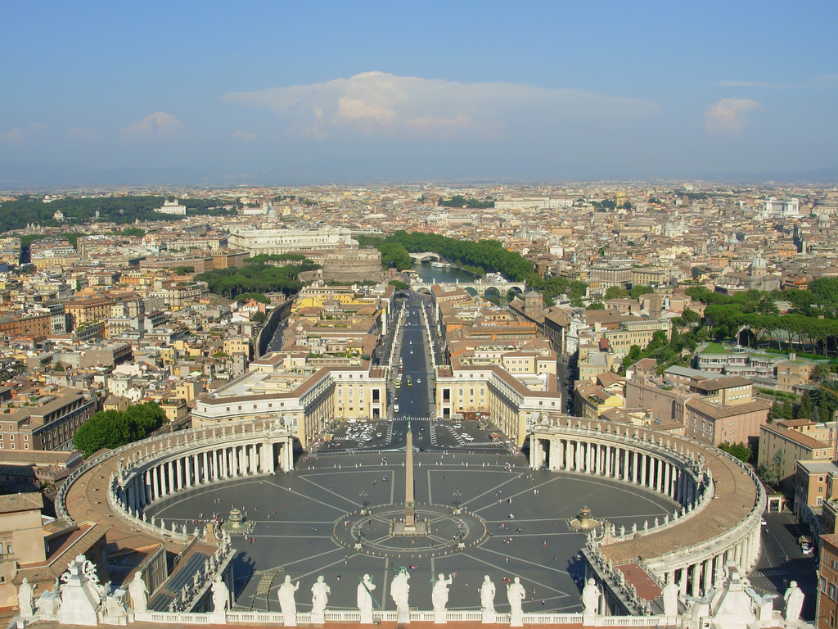
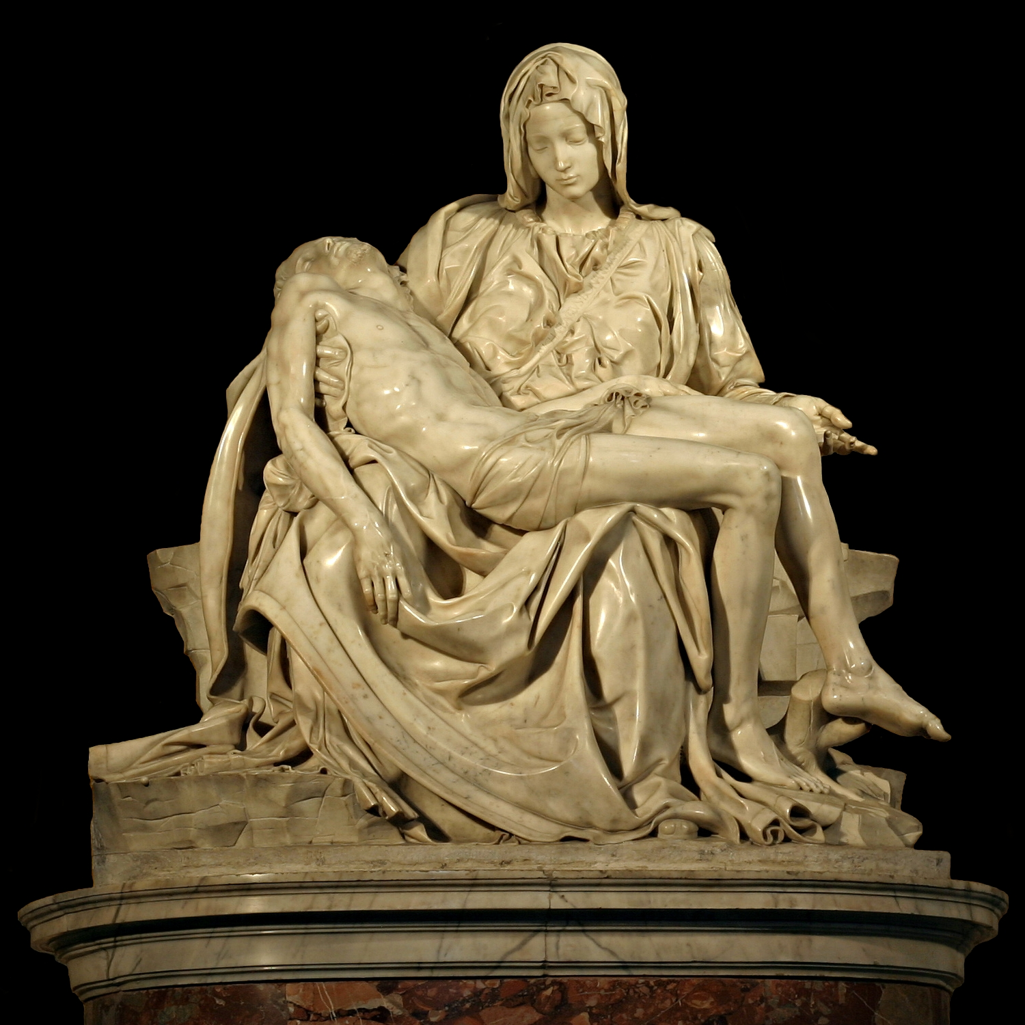
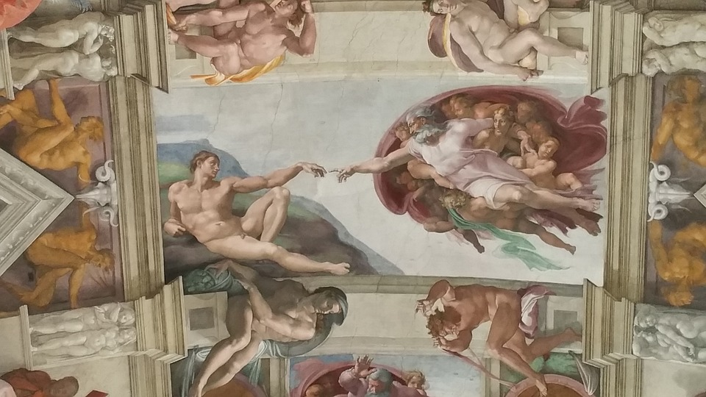
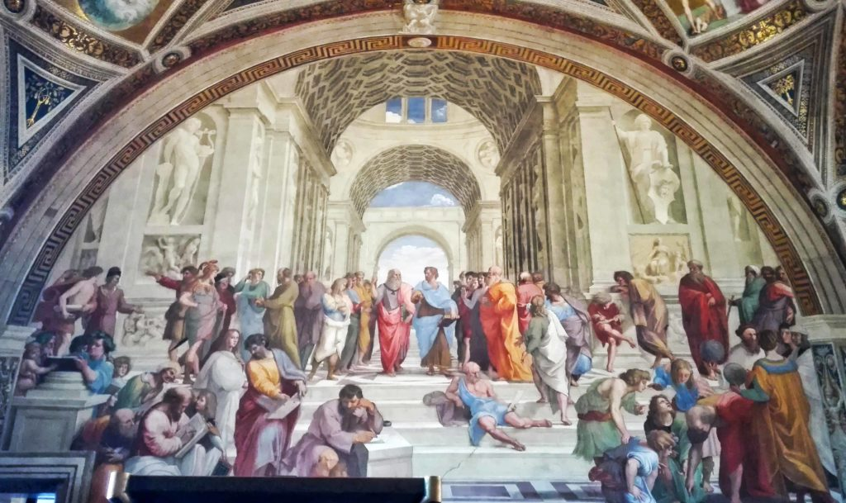
St Peter's Square at night
ST. Peter’s Square
Michelangelo’s masterpieces
Sistine Chapel: The last Judgement
The Pietà
Sistine Chapel: The creation of Adam
Vatican Museums: Raphael’s rooms
It continues with the Renaissance...

Slide 7
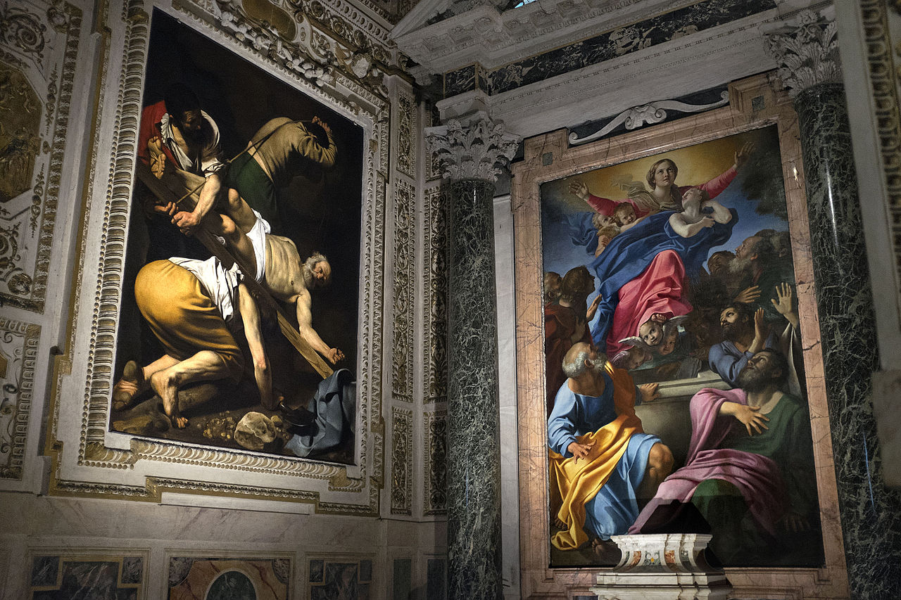
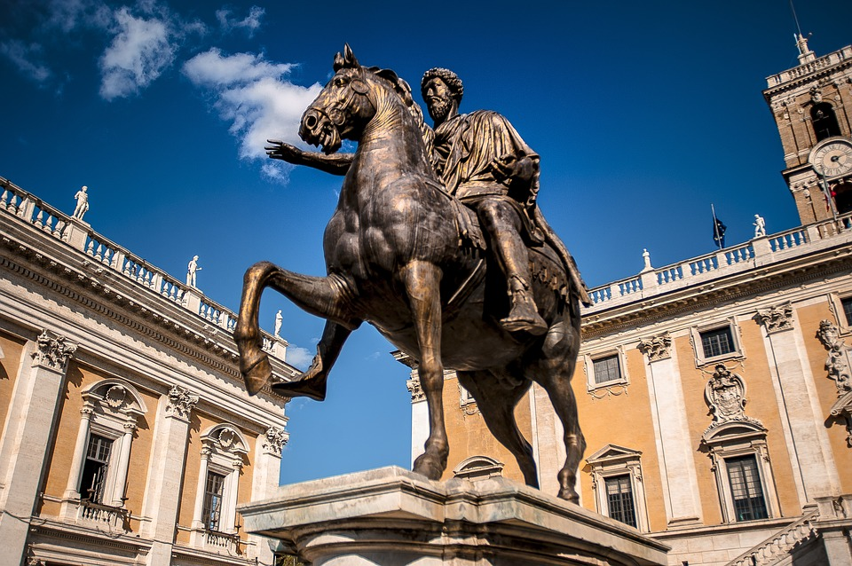
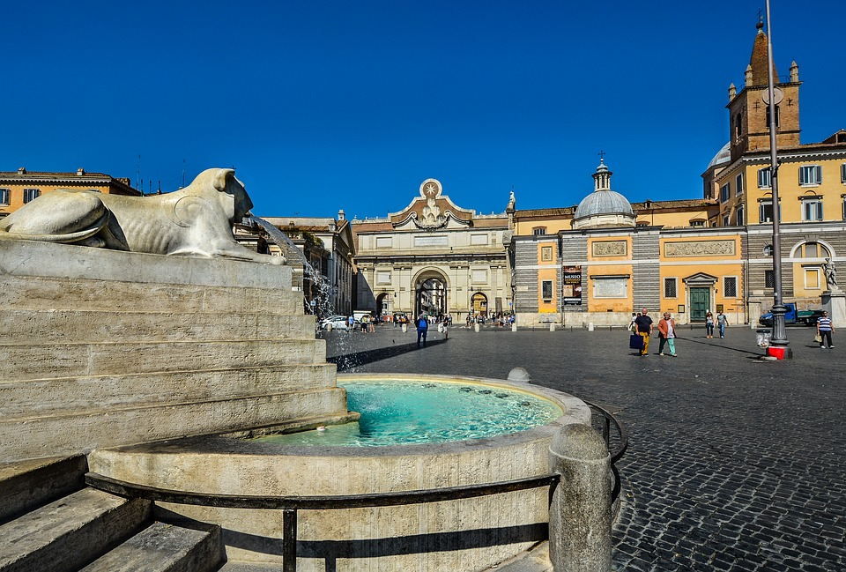
Caravaggio’s paintings
in Santa Maria del Popolo
Piazza del Campidoglio and
statue of Emperor Marcus Aurelius
Piazza del Popolo
Still Renaissance

Slide 8
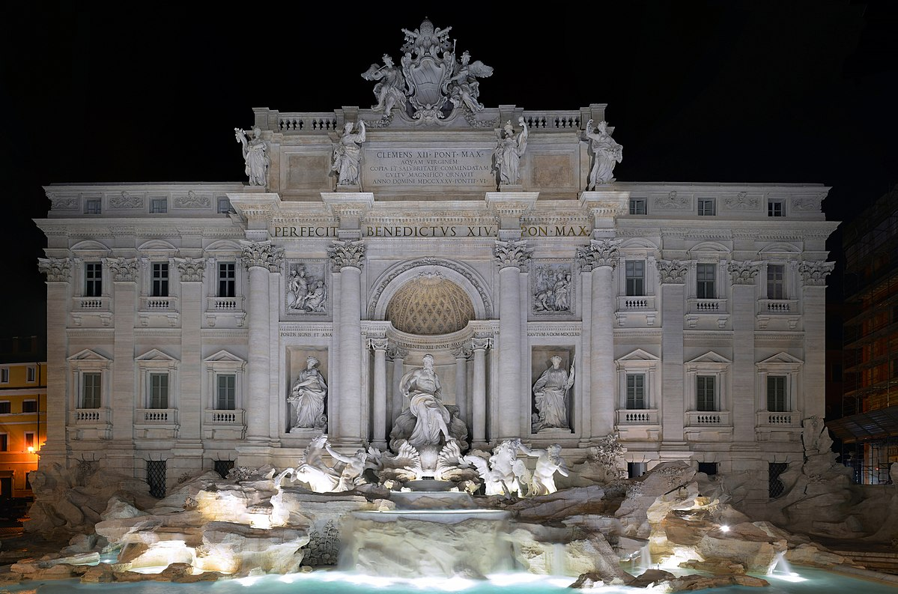
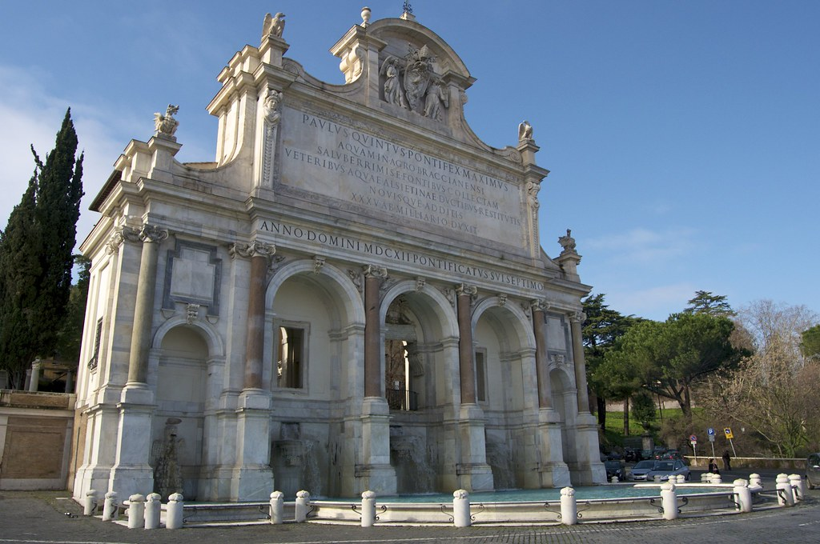
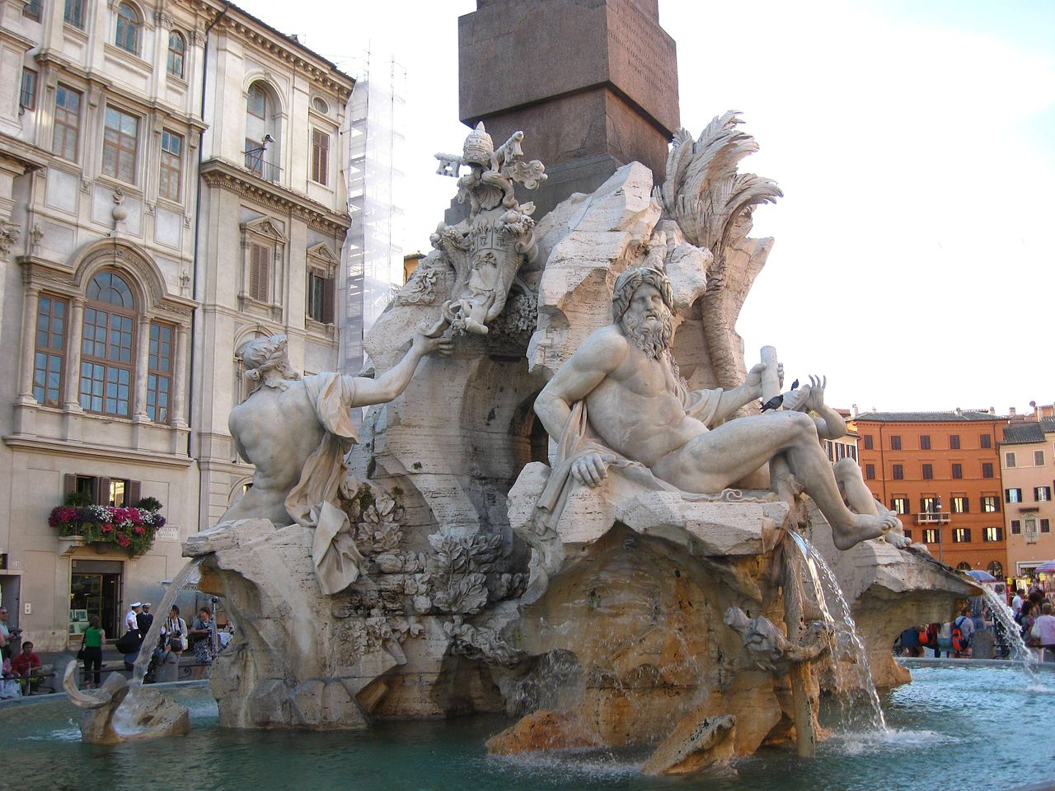
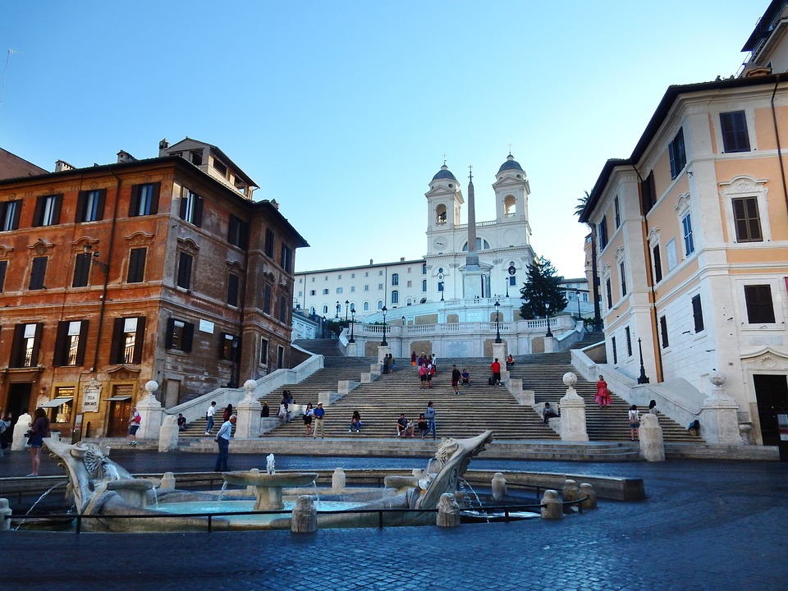
Trevi fountain
Acqua Paola Fountain
Fountain of the Four Rivers by Bernini in Piazza Navona
Piazza di Spagna and the Spanish step
...and the Baroque...

Slide 9
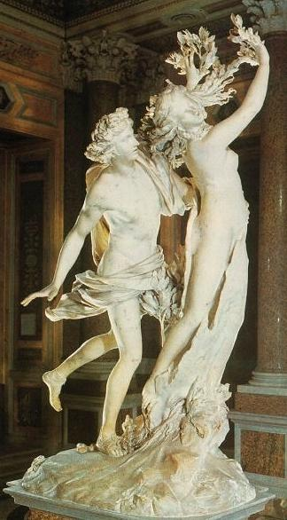
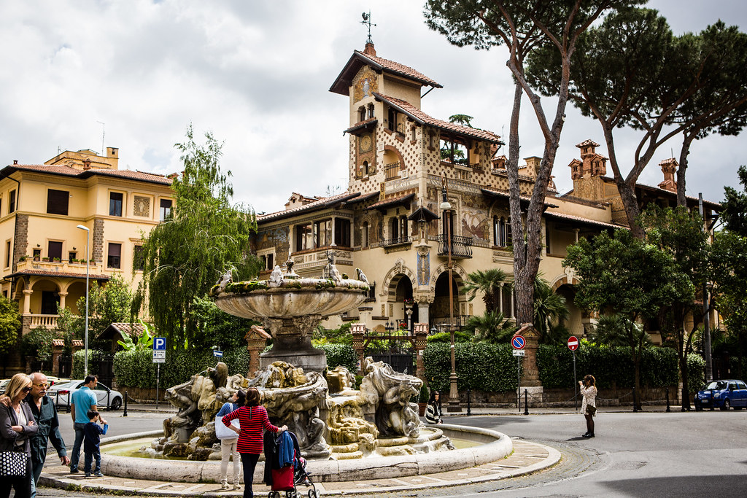
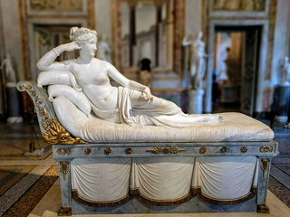
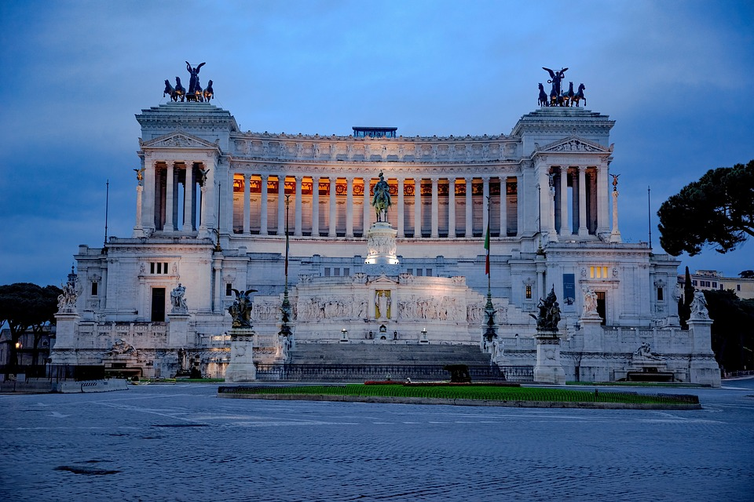
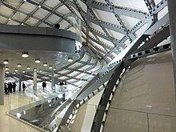
Apollo and Daphne, by Bernini in Borghese Gallery
Paolina Borghese By Canova in Borghese Gallery
Quartiere Coppedè a mixture of Art Nouveau or Liberty and Art Decò
Vittoriano or Altar of the Fatherland
Roma Convention Center ‘La Nuvola’ By Fuksas
... Up to Neoclassicism and Modern Age

