Slide 1
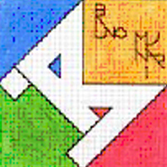
“COME WITH US” eTwinning PROJECT
TOPIC 4: WATER
CLASSE III A - WALT DISNEY

Slide 2
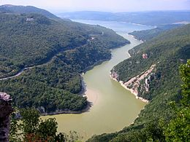
TOPIC 4: LIFE IN OUR RIVER
HELLO FRIENDS ! I AM THE RIVER TIBER !
COME WITH US TO KNOW ME BETTER!

Slide 3
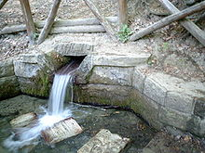
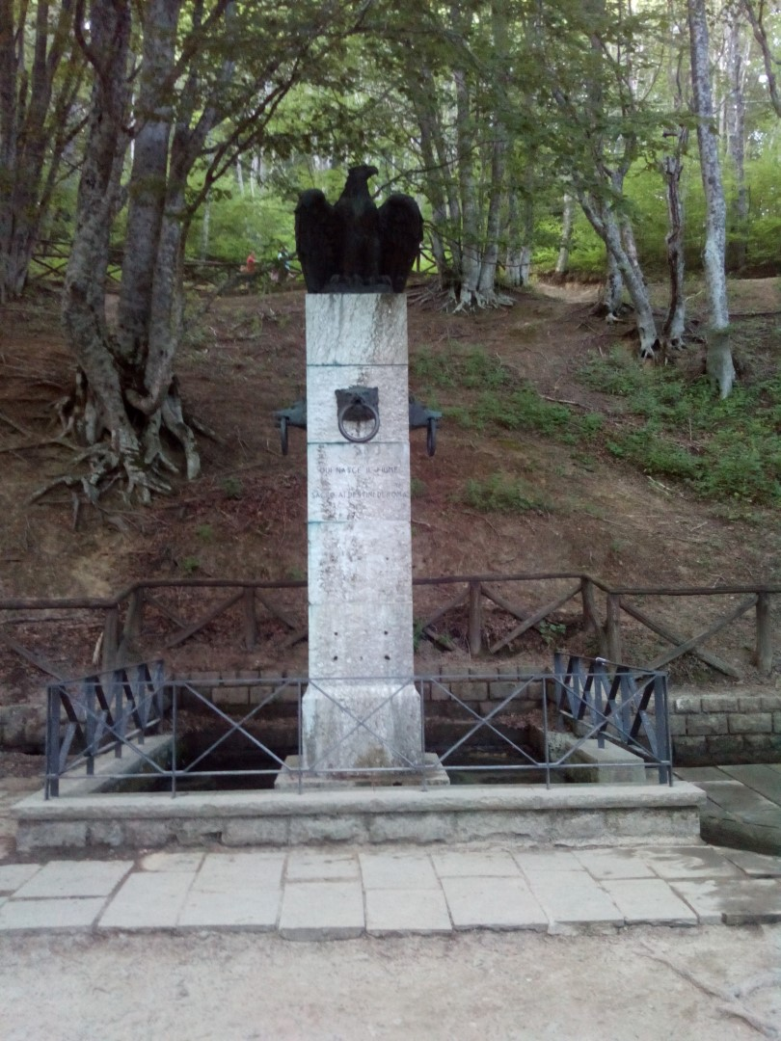
Source of the river coulumn with eagle
I RISE AT MOUNT FUMAIOLO IN THE REGION
OF “EMILIA ROMAGNA”.

Slide 4
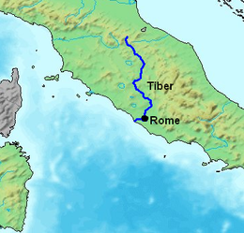
The path of the river
I FLOW FOR 405 KILOMETRES THROUGH THE REGIONS OF TUSCANY, UMBRIA AND LAZIO.

Slide 5
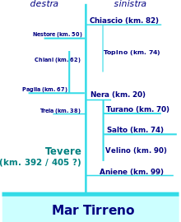
Tributaries
I HAVE GOT A LOT OF TRIBUTARIES. THE MOST IMPORTANT IS THE RIVER “ANIENE”.

Slide 6
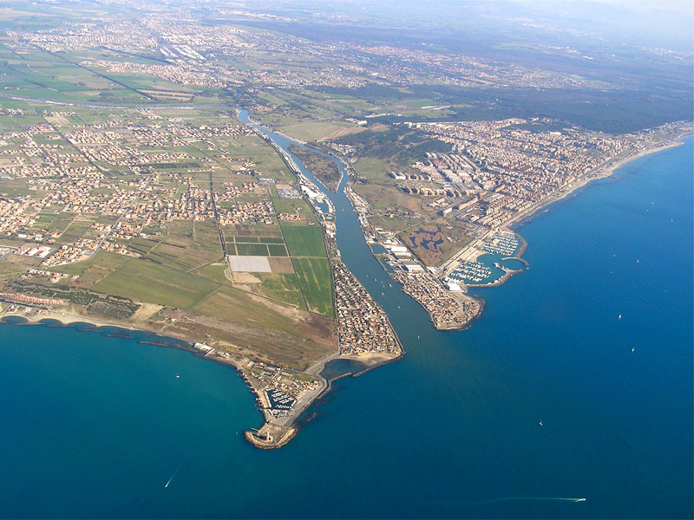
The mouth of the river Tiber
I MEET THE TYRRHENIAN SEA THROUGH A MOUTH OF DELTA, SPLIT INTO TWO BRANCHES:
“FIUMARA GRANDE” AND “CANALE DI TRAIANO”.

Slide 7
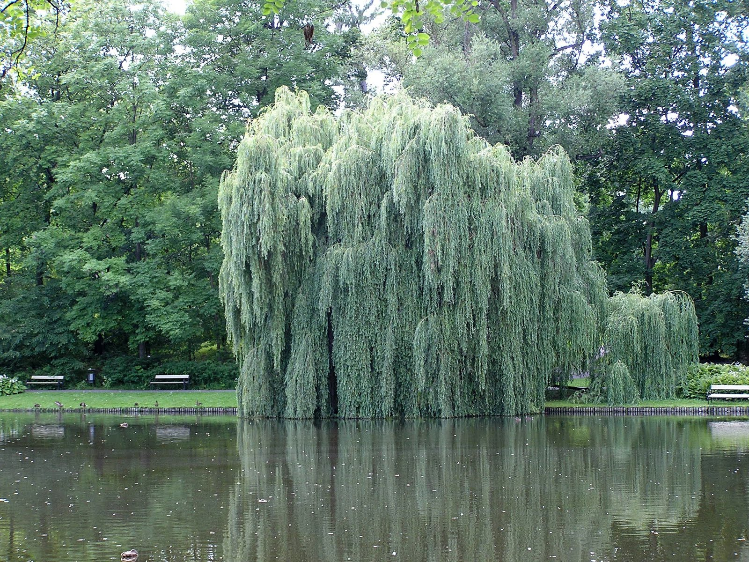
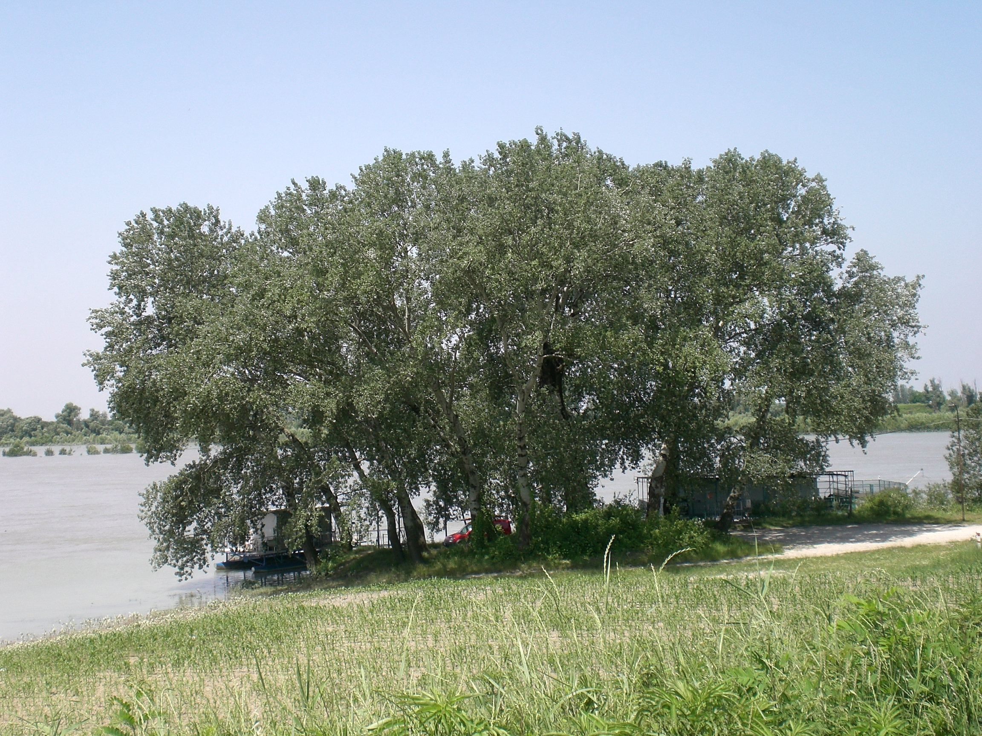
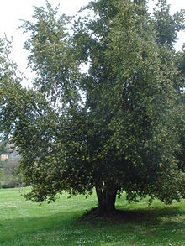
Flora
Willow
White poplar
Laurel
DURING MY PATH I MEET DIFFERENT TREES,
LIKE WHITE POPLARS, WILLOWS AND LAURELS.

Slide 8
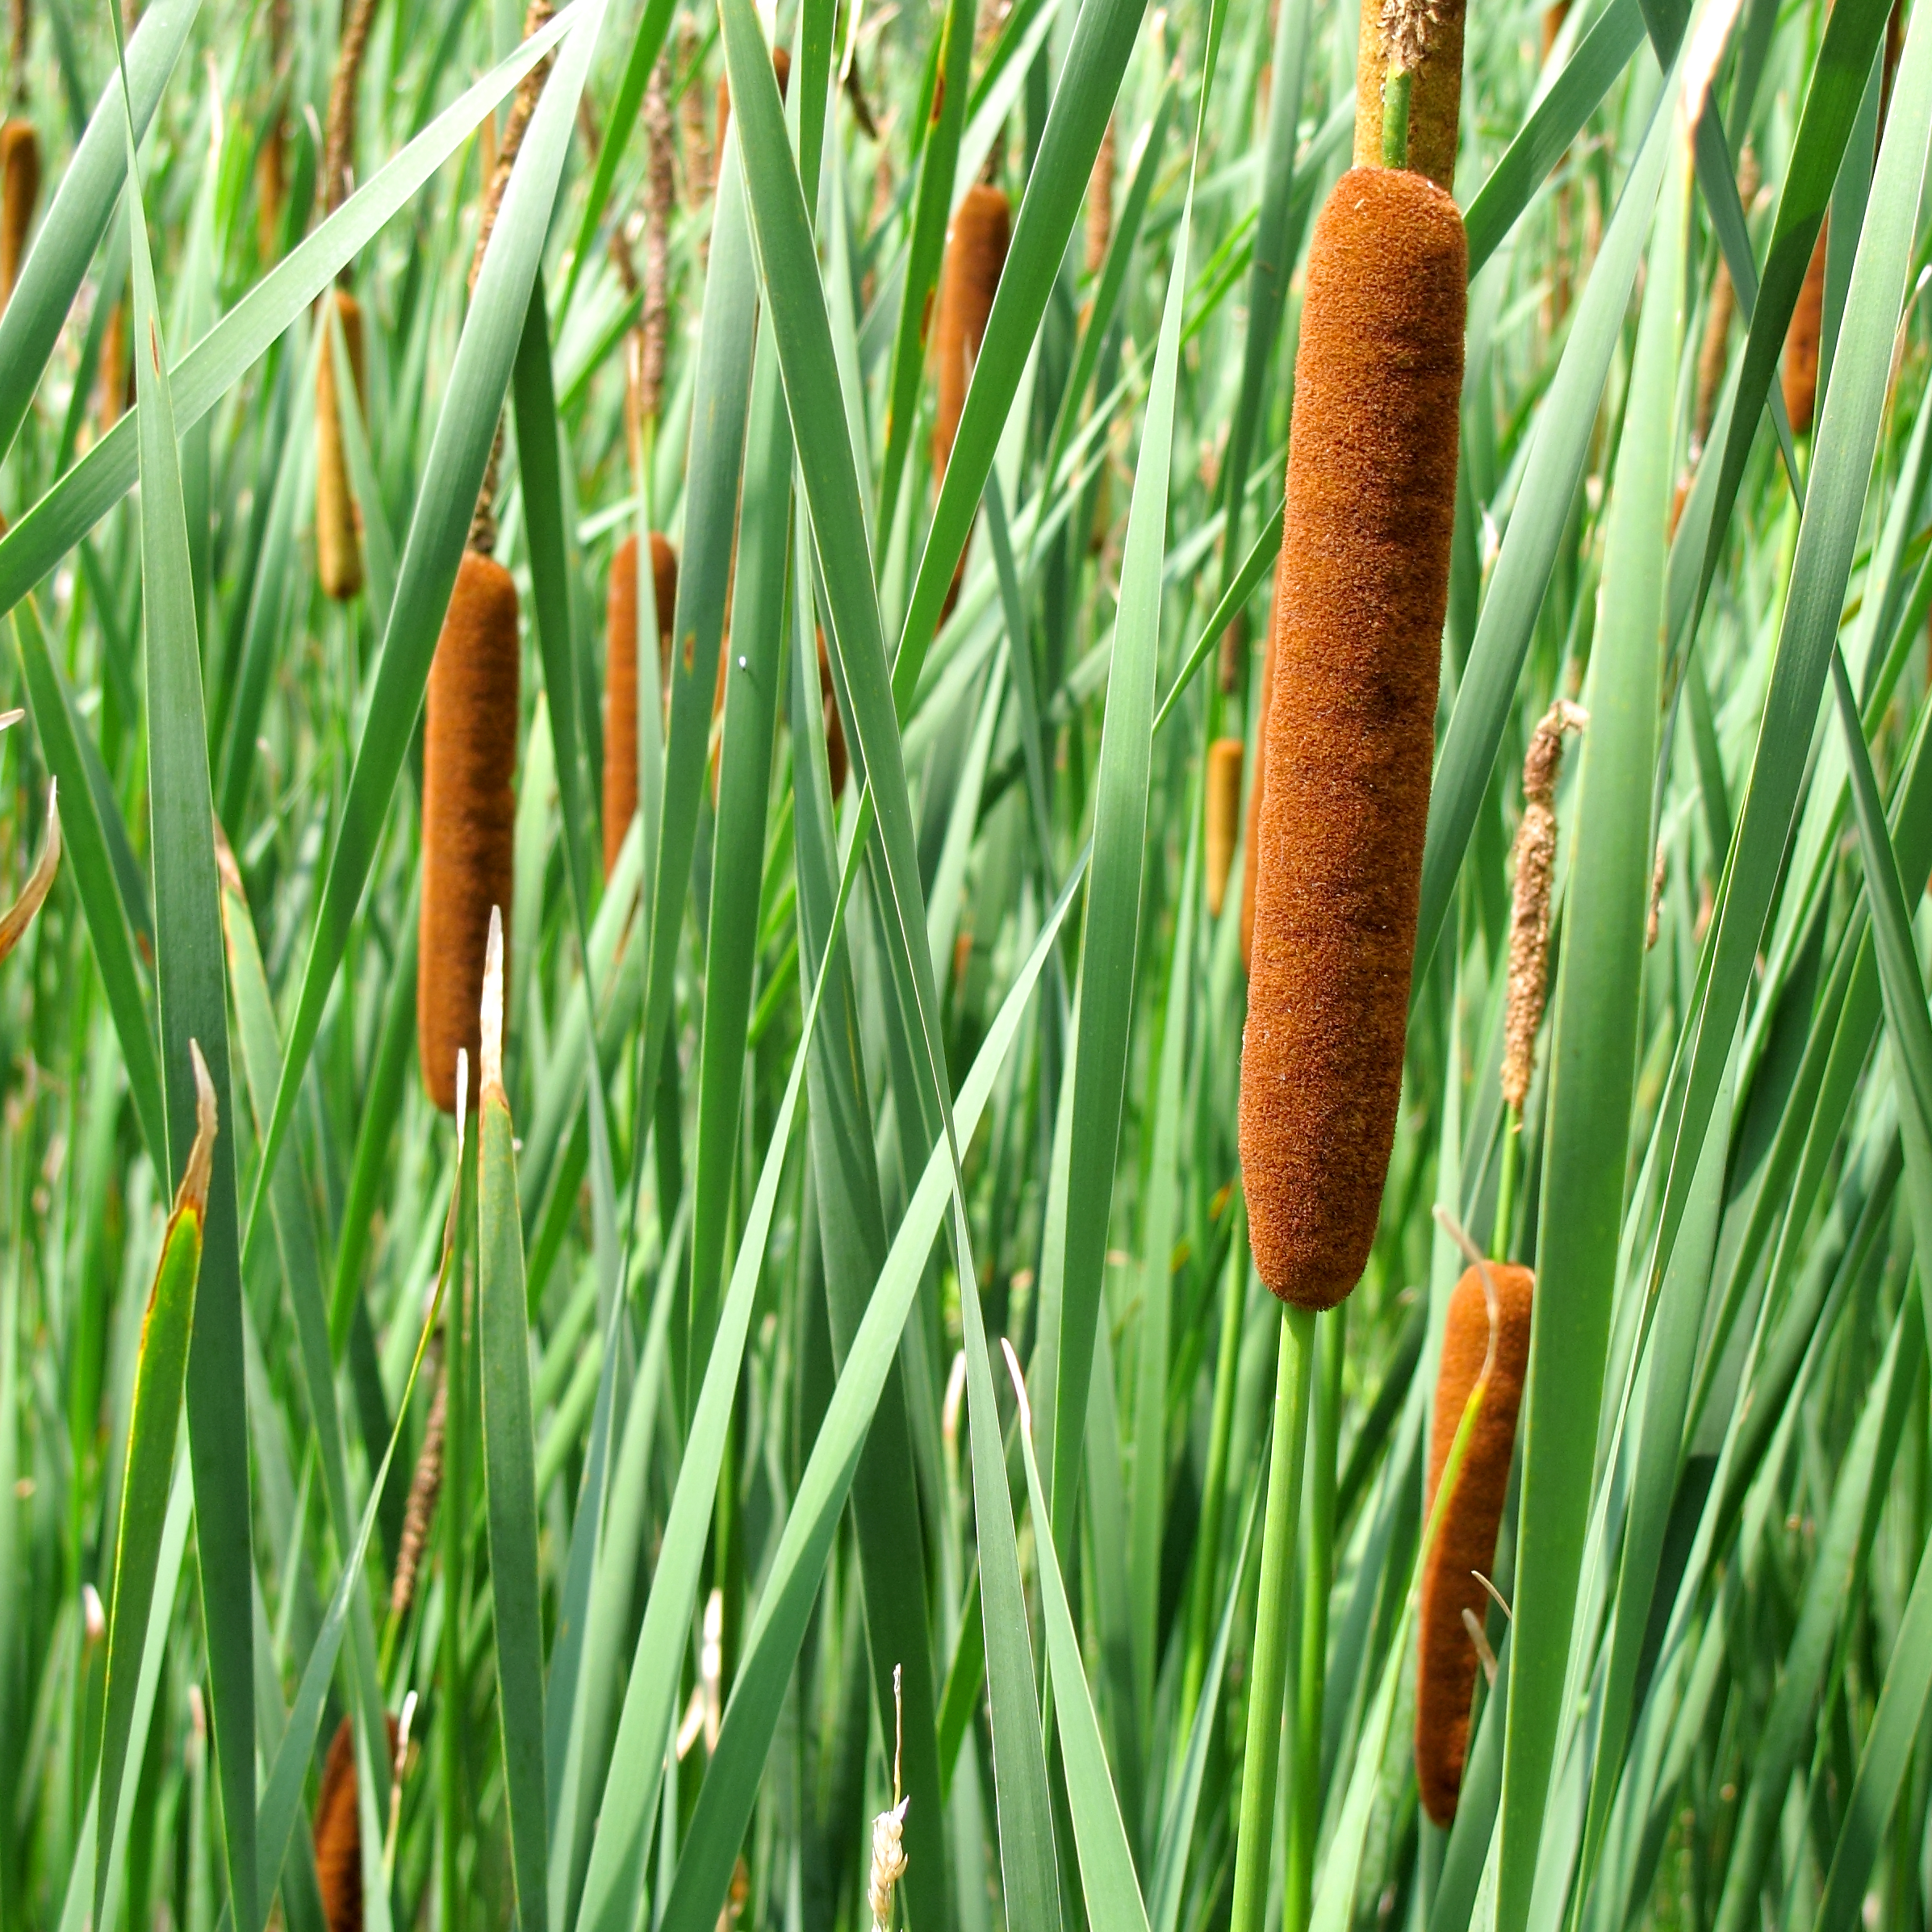
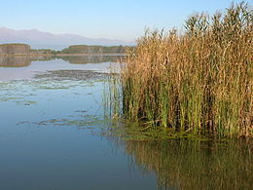
Flora
Reeds
Canes
ON THE RIVER BANKS A LOT OF PLANTS GROW, LIKE REEDS AND CANES.

Slide 9
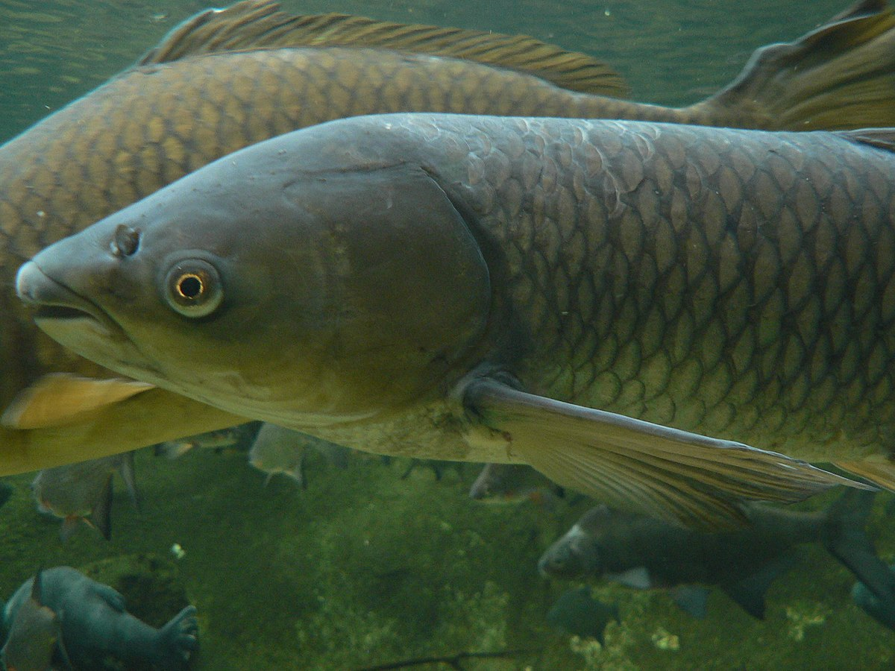
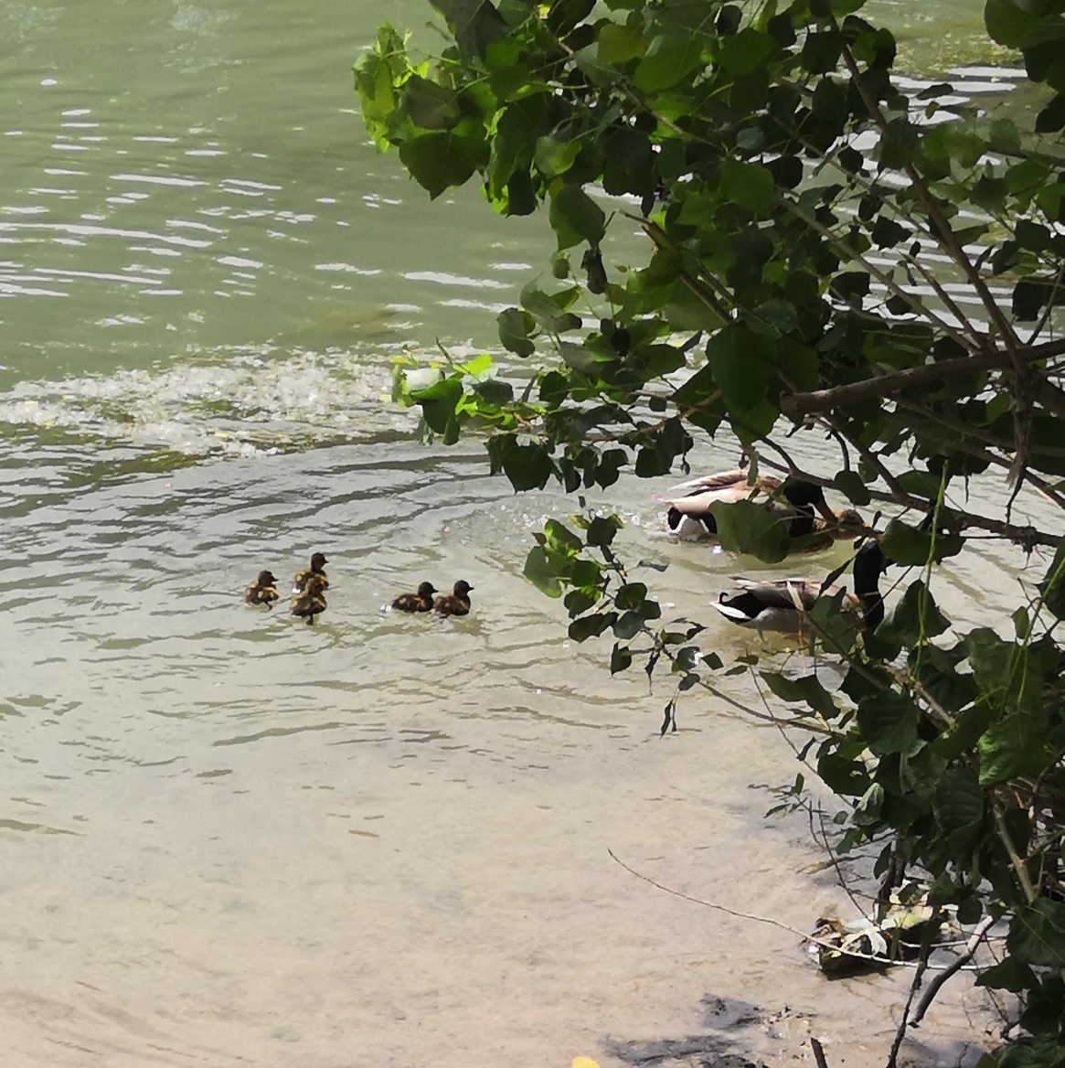
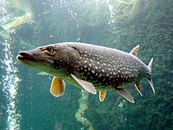
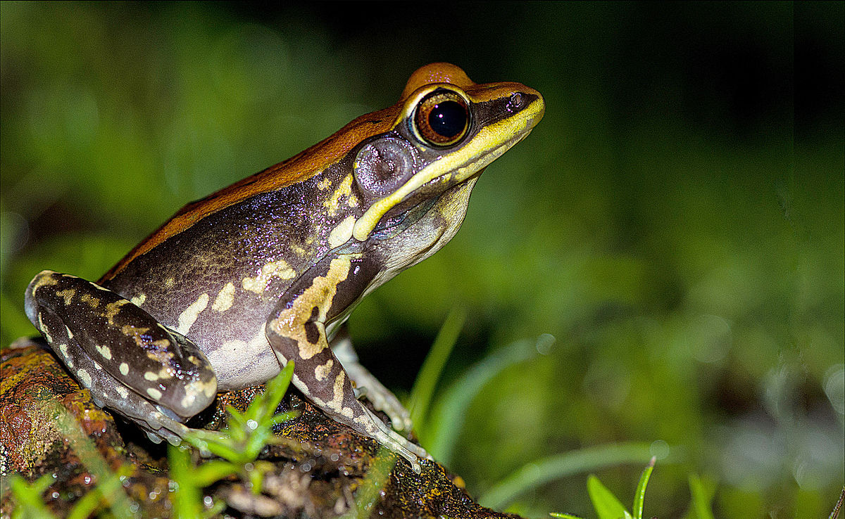
Fauna
Carp
Ducks and ducklings
Pike
Frog
THESE FISH, DUCKS AND FROGS
CAN SWIM IN ME.

Slide 10
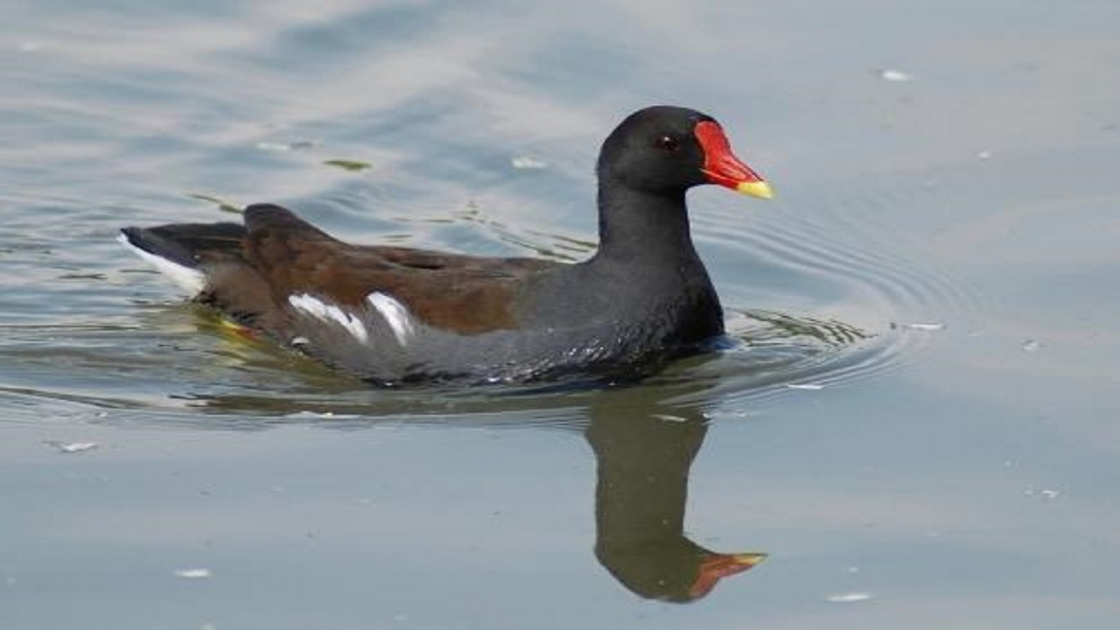
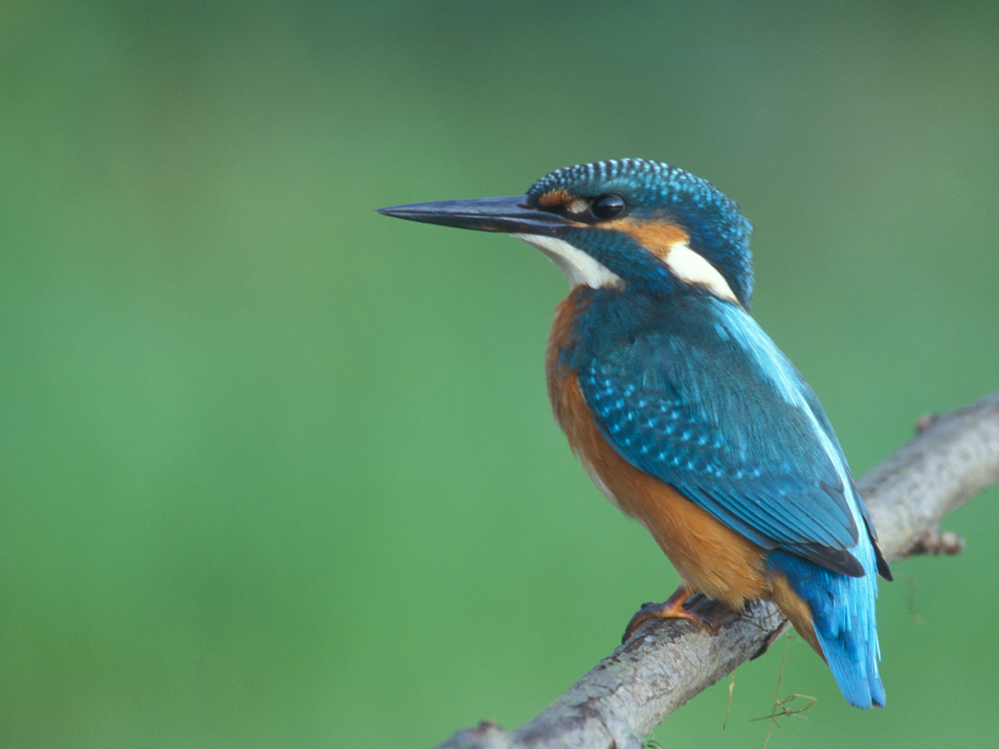
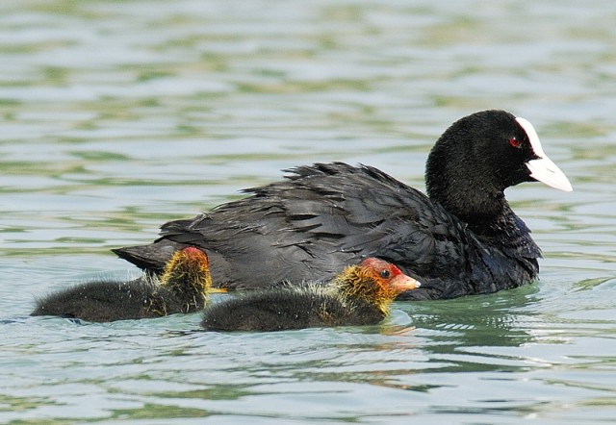
Fauna
Moorhen
Kingfisher
Coot
THESE BIRDS CAN FLY ABOVE ME.
THEY SING AMAZING MELODIES.

Slide 11
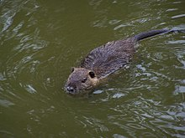
Fauna
ON MY BANKS YOU CAN SEE SOME RODENTS LIKE MICE AND COYPUS, WHICH ARE SIMILAR TO BEAVERS BUT THEY DON’T EAT WOOD.

Slide 12
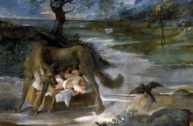
The river in the past
A LEGEND SAYS ROMULUS AND REMUS WERE ABANDONED ON MY WATER AND MY PLANTS FED THEM UNTIL THE SHE-WOLF RESCUED THEM.

Slide 13
Pater Tiberius
I WAS CONSIDERED A GOD. ON THE TIBER ISLAND (AN ANCIENT FORD) THERE IS MY TEMPLE. I WAS CELEBRATED ON THE 8TH DECEMBER.

Slide 14
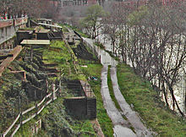
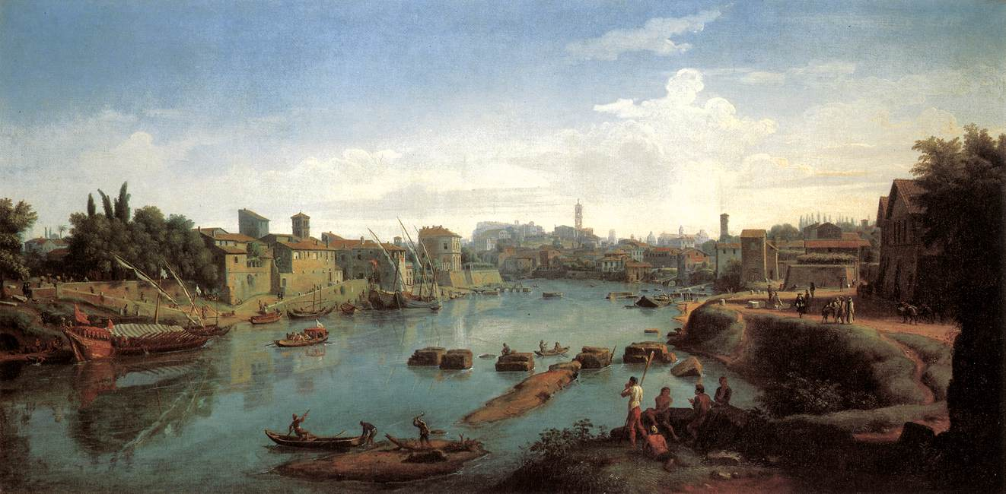
Trade and commerce
THE ROMANS CARRIED PEOPLE AND THINGS ON ME. THE GOODS ARRIVED BY SEA FROM THE HARBOUR OF OSTIA AND REACHED THE EMPORIUM.

Slide 15
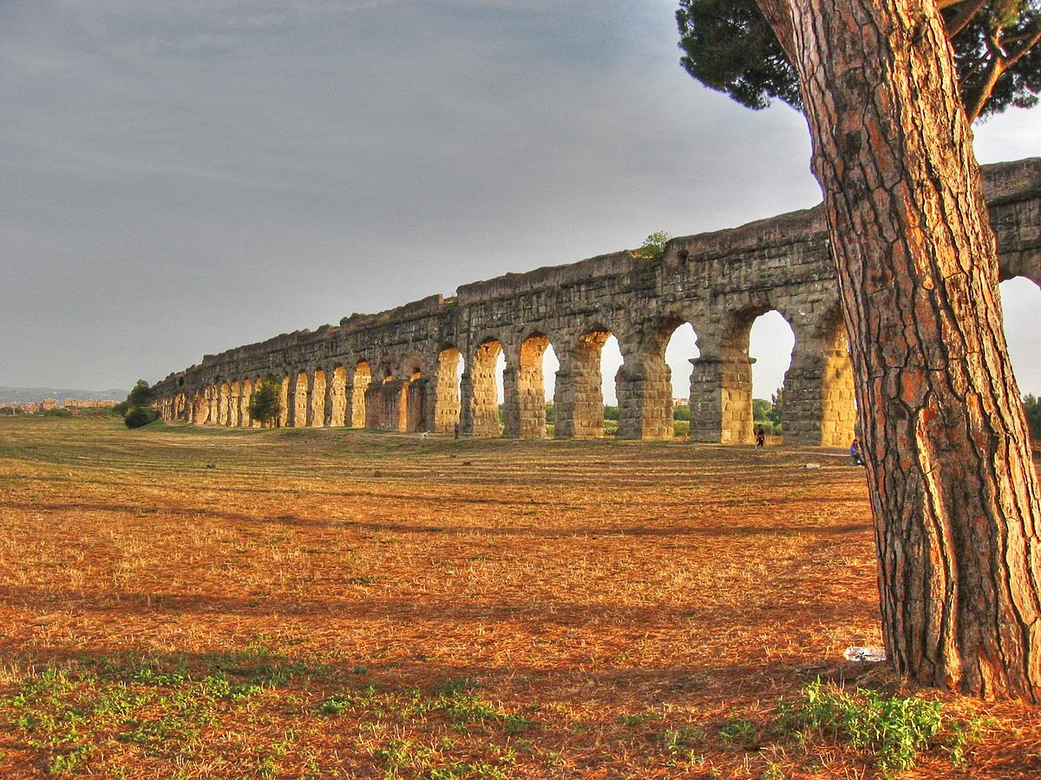
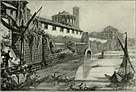
In ancient Rome
Roman aqueduct
Cloaca Maxima
MY WATER WAS CARRIED TO THE CITY BY AQUEDUCT. THE ROMANS CONNECTED ME WITH A SEWER SYSTEM.

Slide 16
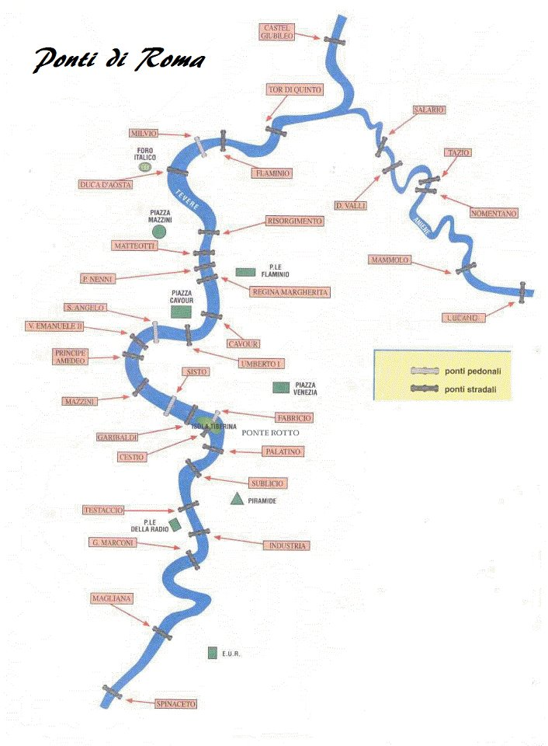
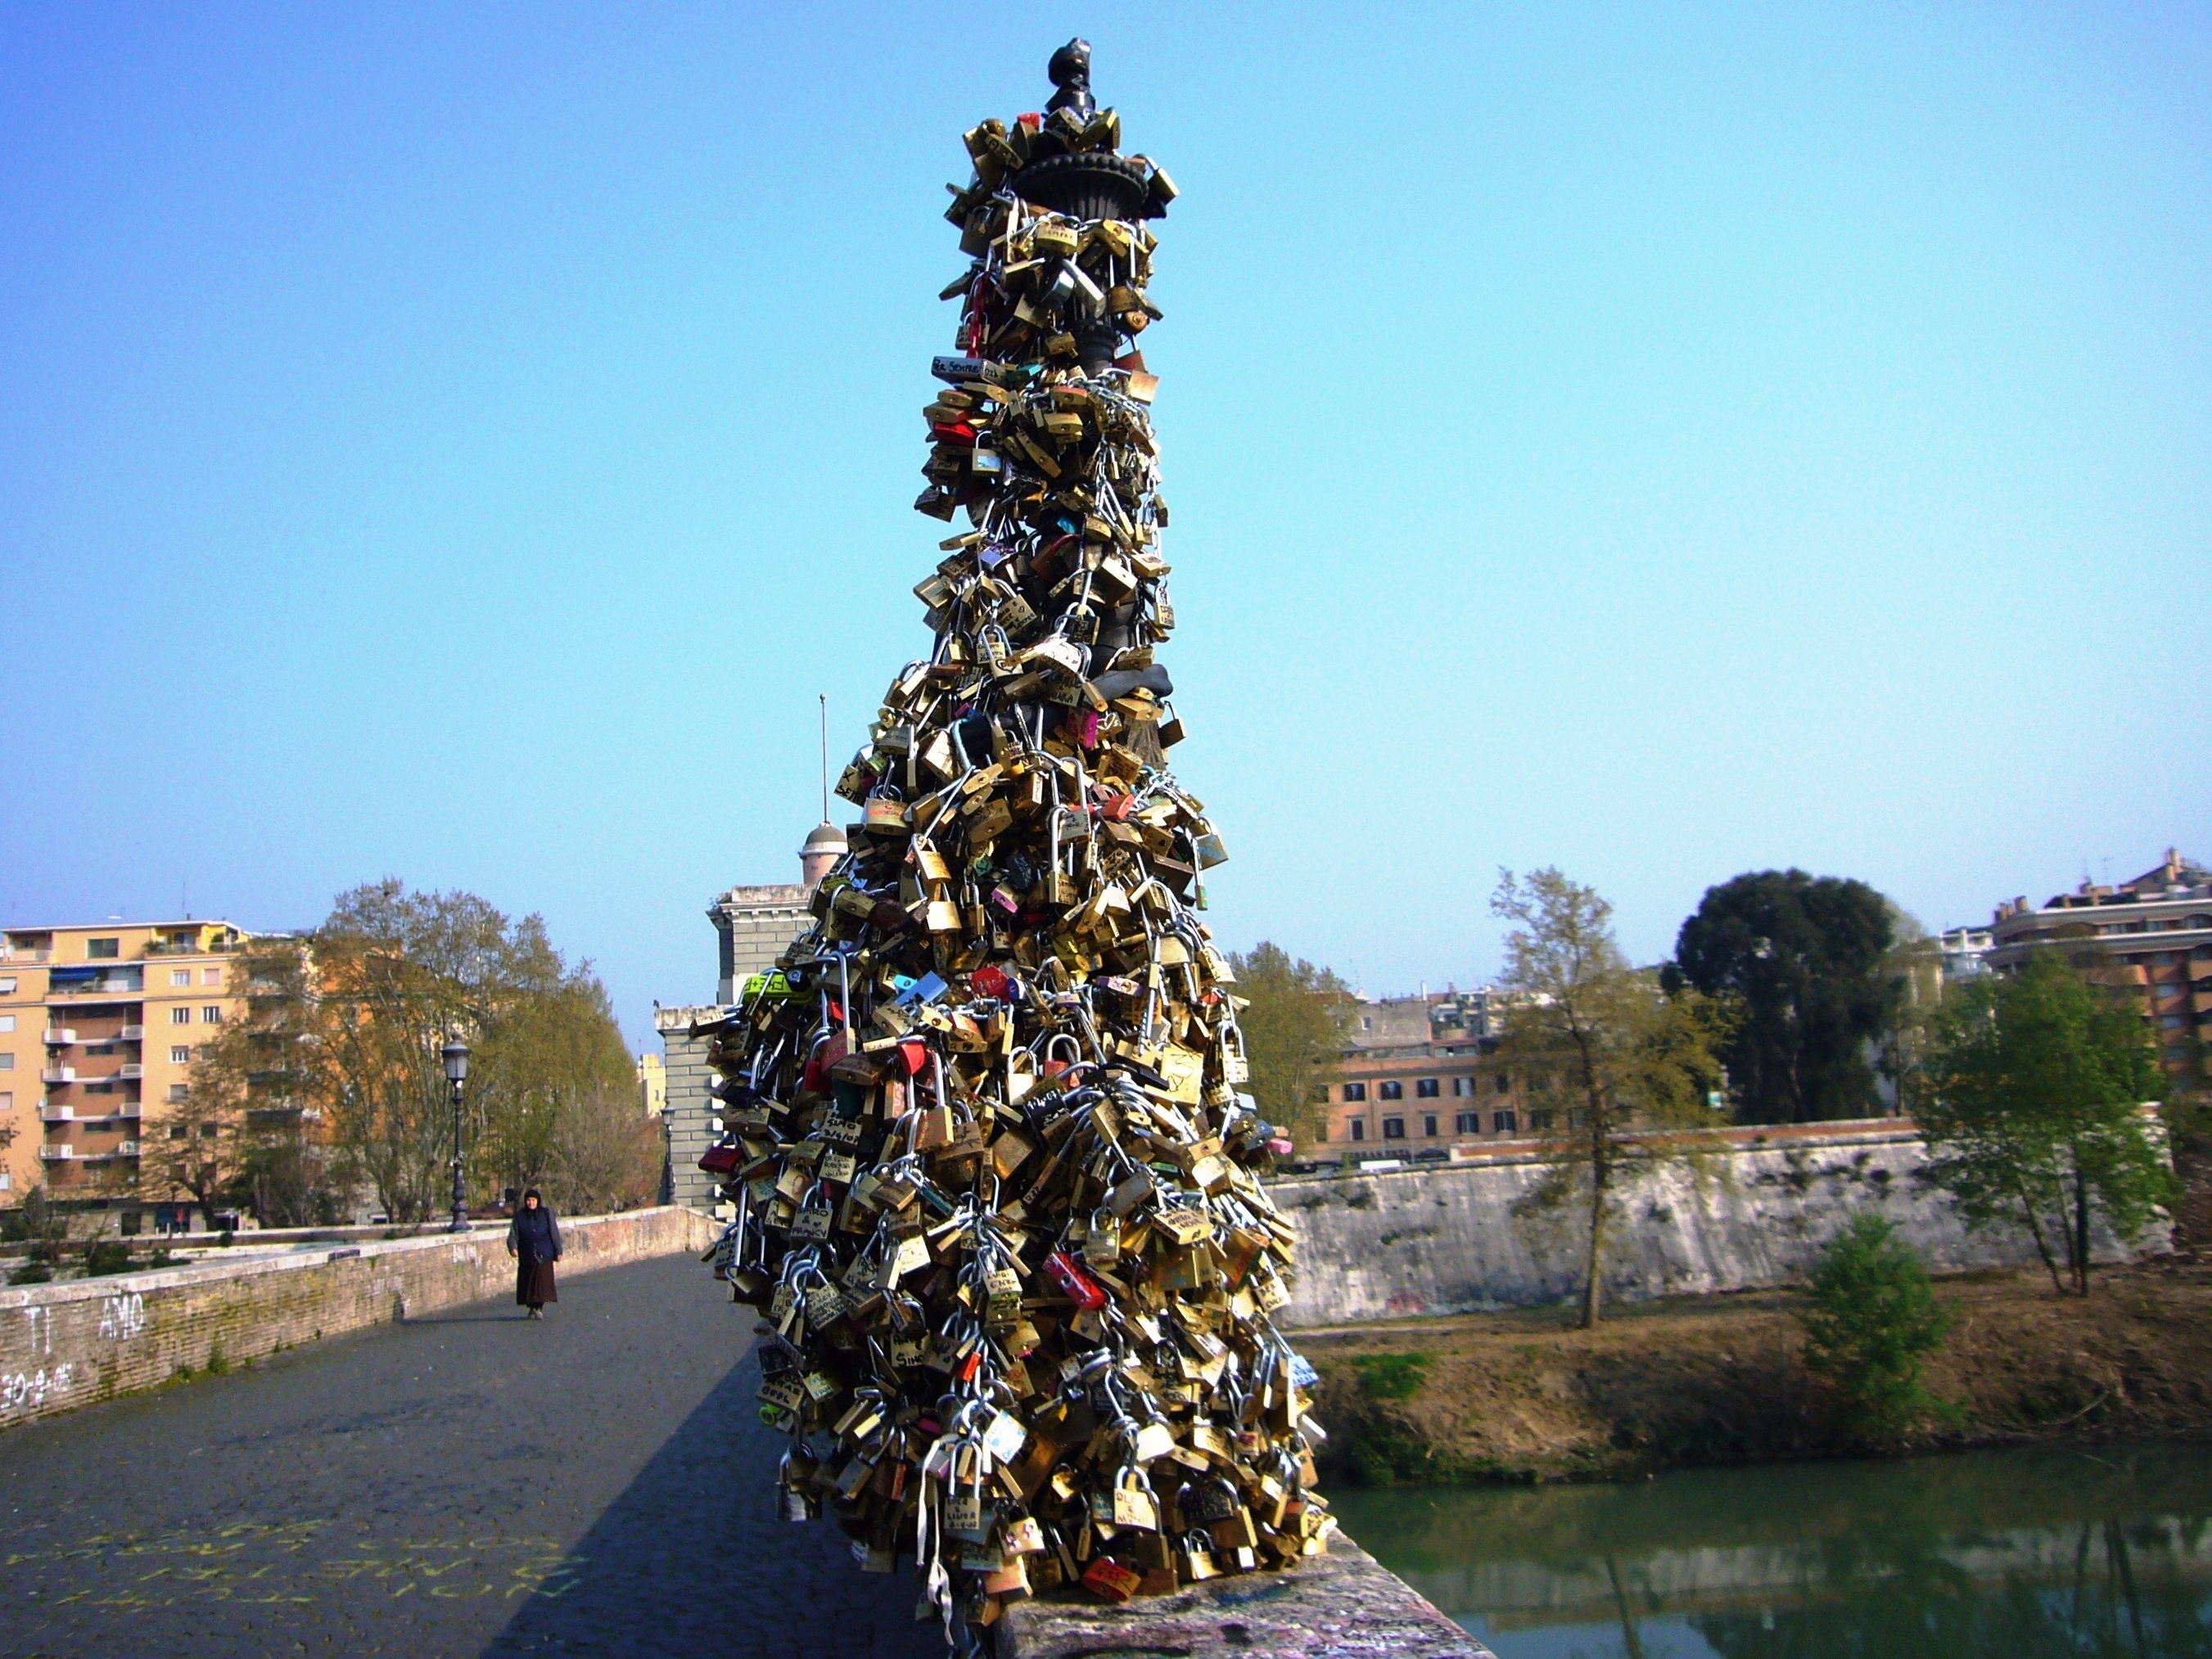
In the present
YOU CAN CROSS ME THROUGH A LOT OF BRIDGES. LOVERS ATTACH PADLOCKS TO A LAMPPOST ON OLD “MILVIAN BRIDGE”.

Slide 17
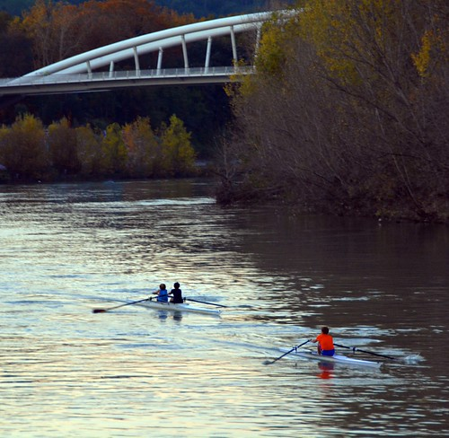
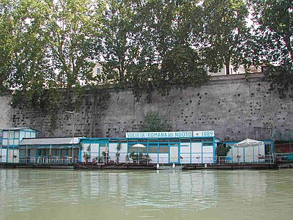
Sport
YOU CAN DO CANOEING AND RAFTING
IN MY WATER.

Slide 18
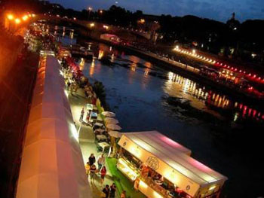
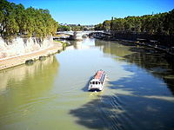
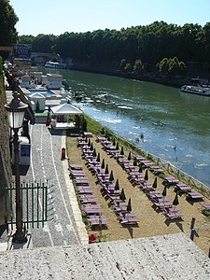
Activites
TOURISTS CAN MAKE A BOAT TRIP. IN SUMMER TIME ON MY BANKS THERE ARE LOTS OF MARKETS AND RESTAURANTS, BARS, MUSIC AND EVEN A BEACH.

