Slide 1
“COME WITH US” eTwinning PROJECT
TOPIC 3: MUSIC
CLASSE V I – ANGELO MAURI

Slide 2
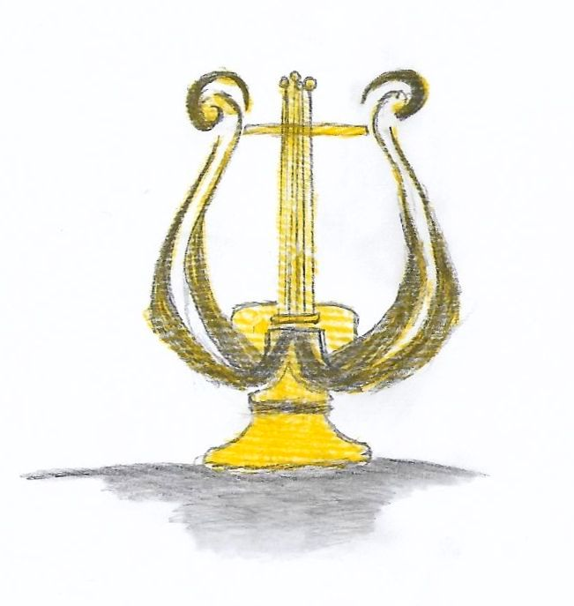
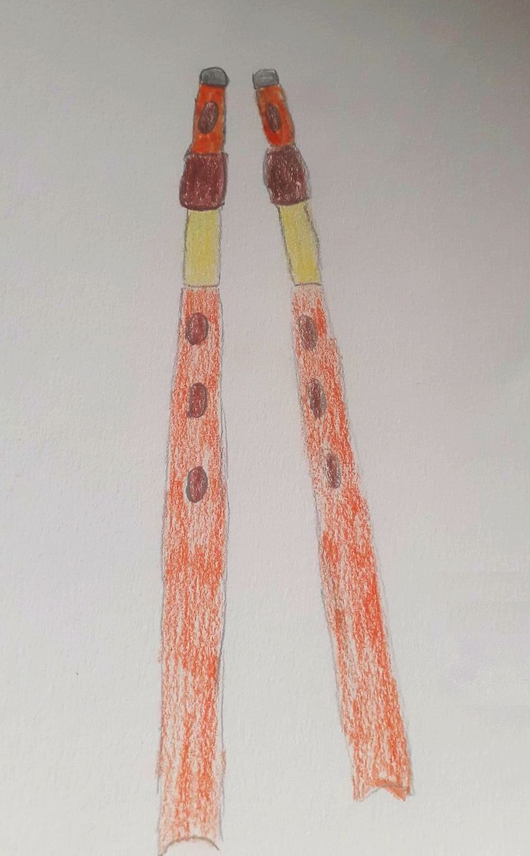
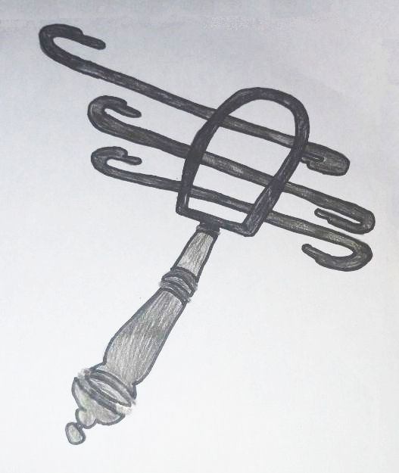
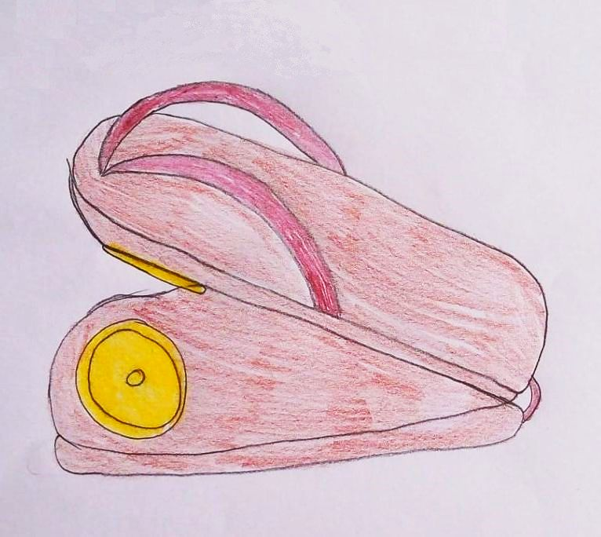
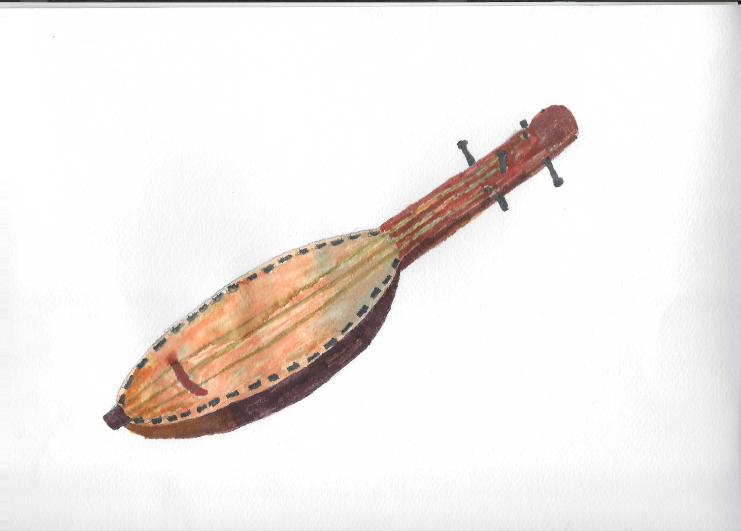
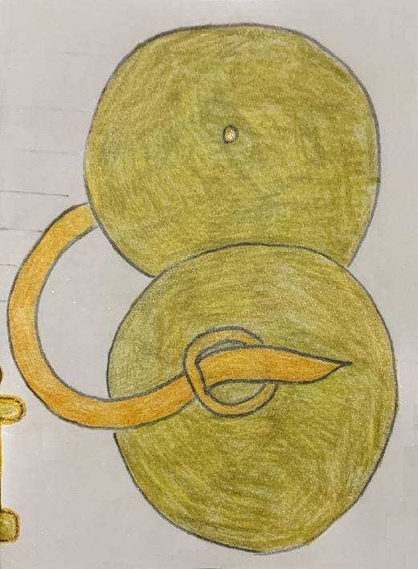
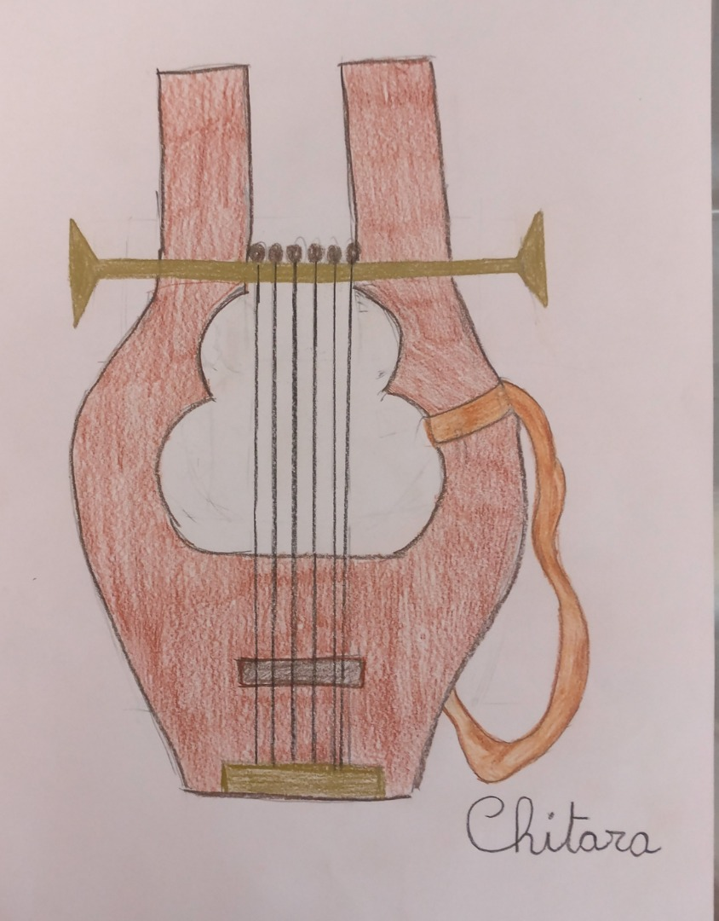
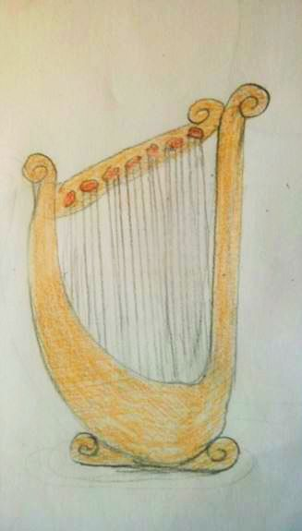
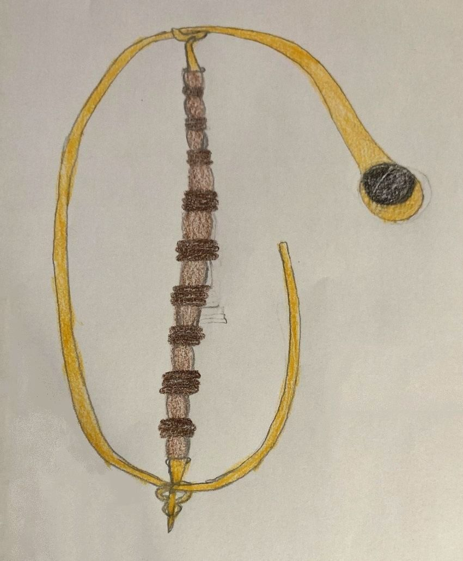
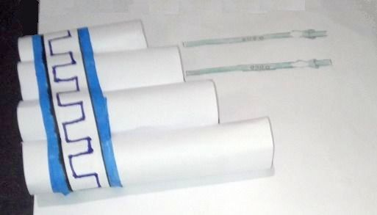
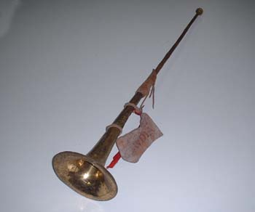
Ancient Rome's Instruments
lyre
sistrum
scabellum
lute
tibia
tuba
cymbala
kithara
flute
cornu
gruppostoricoromano.it
Music is used in military, civil, religious ceremonies and also for gladiator games.

Slide 3
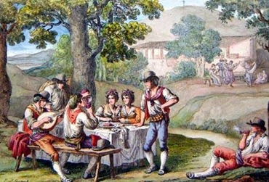
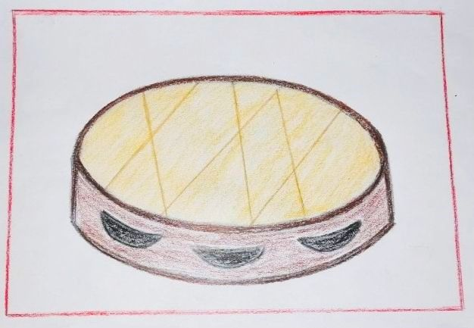
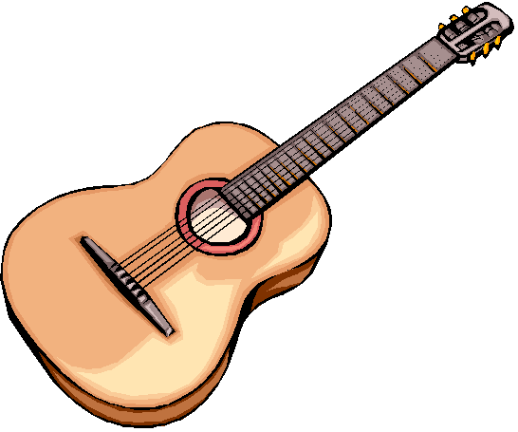
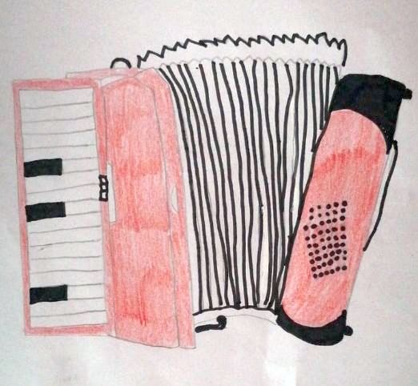
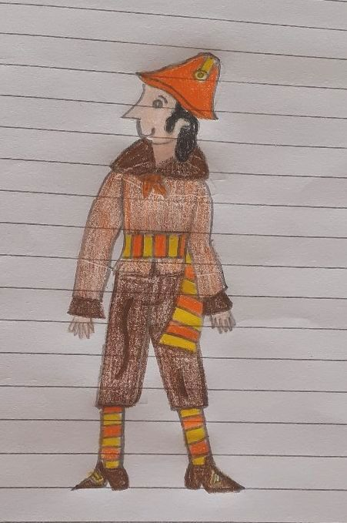
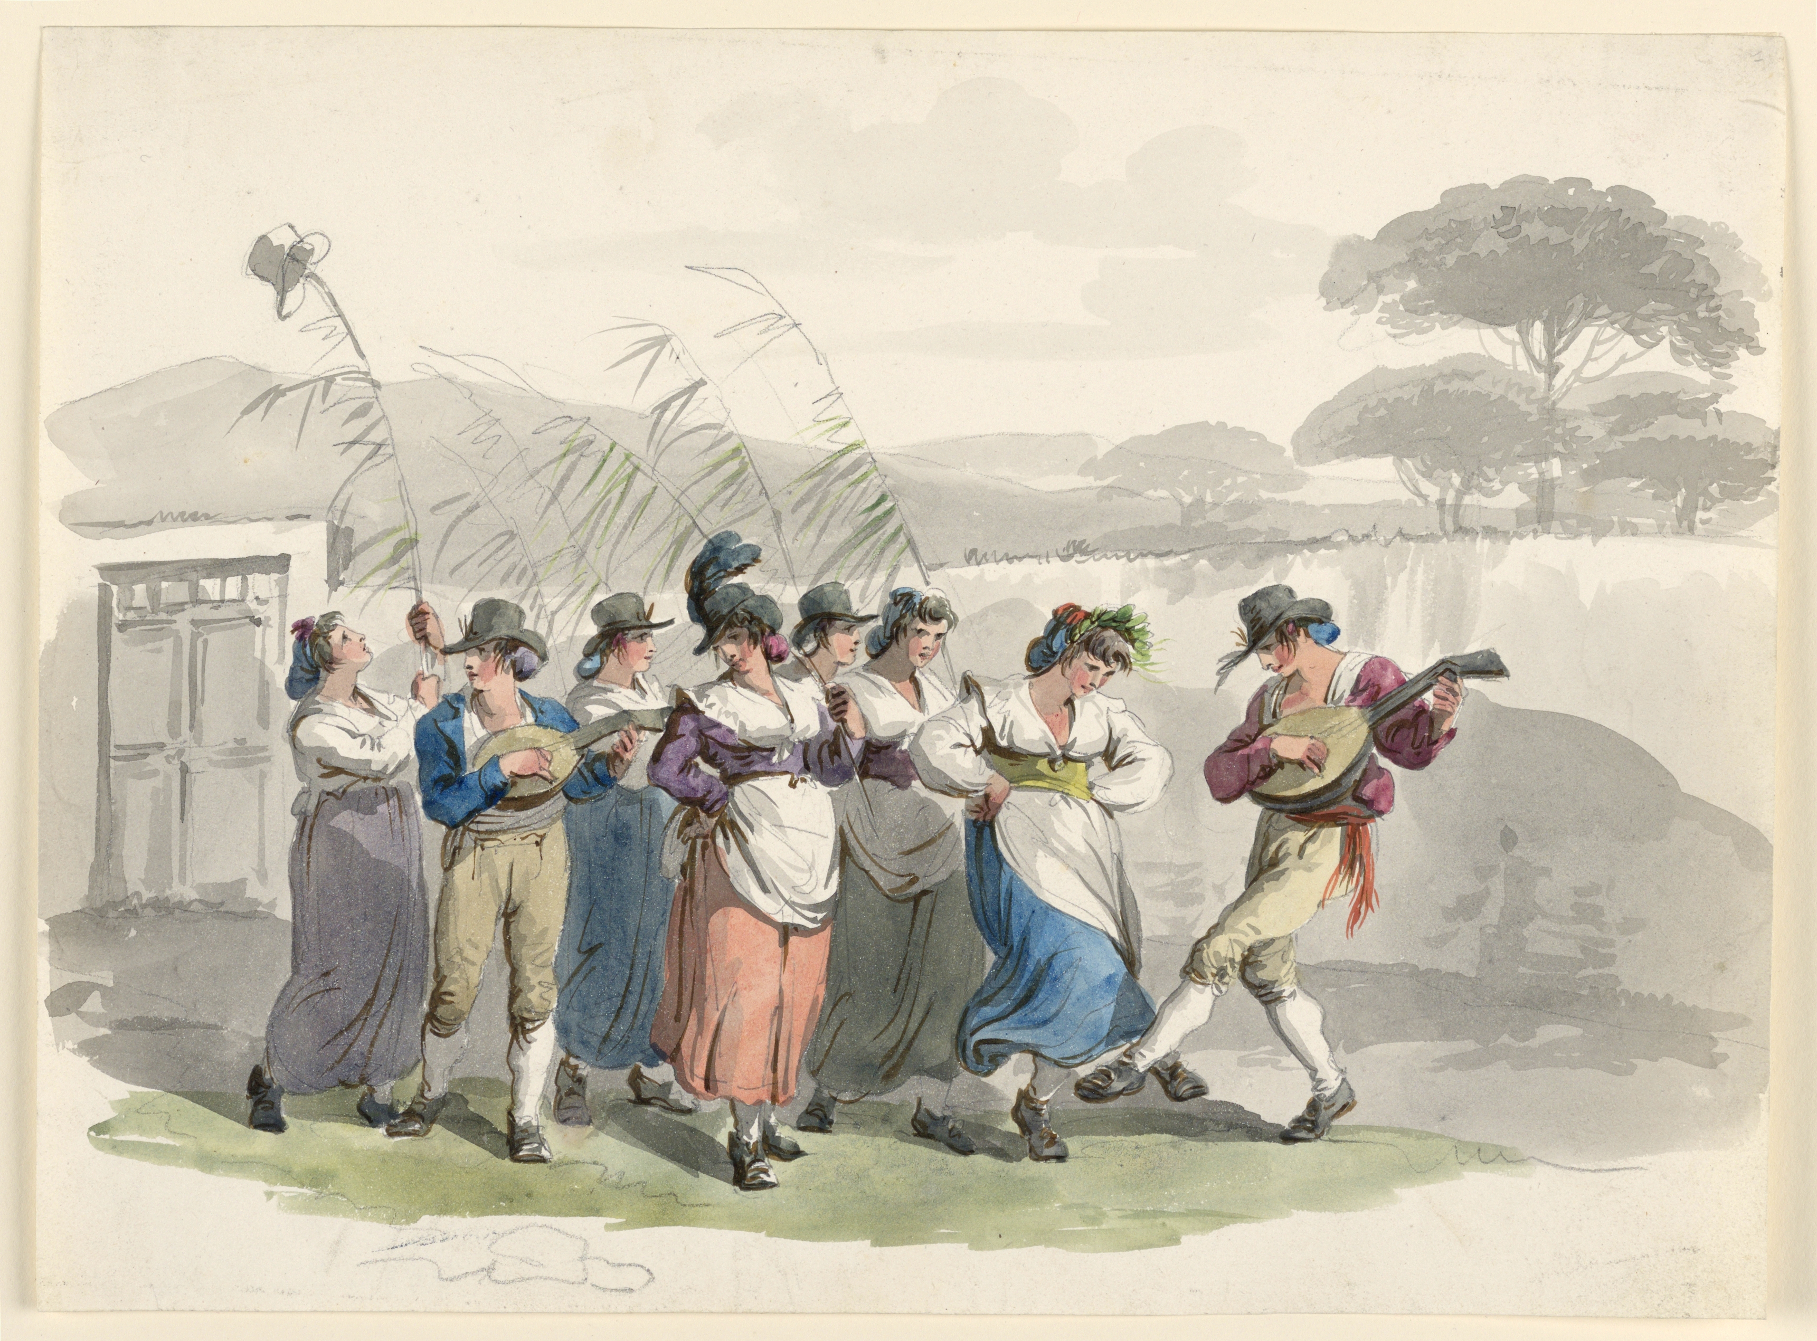
guitar
tambourine
https://www.youtube.com/watch?v=xaPOT3Ji-WY
Trovajoli, Garinei and
Giovannini: Roman musicians
Rugantino
is a Roman Carnival
character: arrogant
but sympathetic
accordion
https://www.youtube.com/watch?v=07dWG98P_u8
TRADITIONAL POPULAR MUSIC

Slide 4
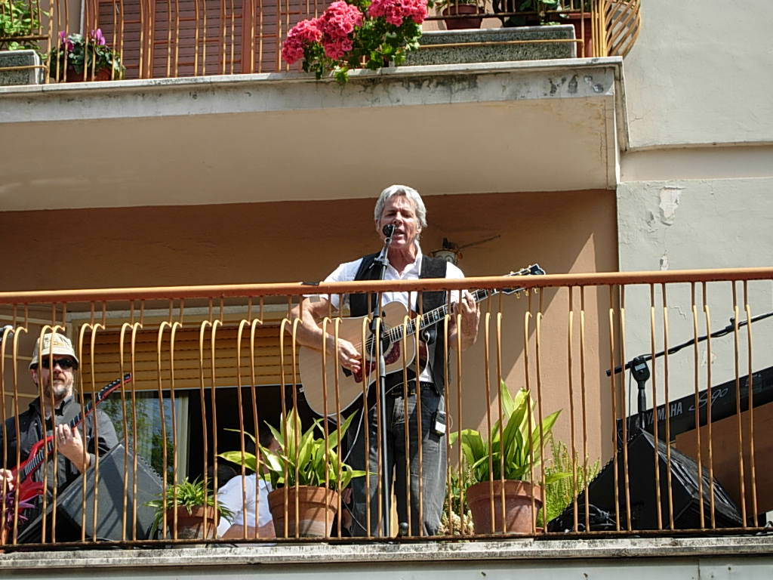
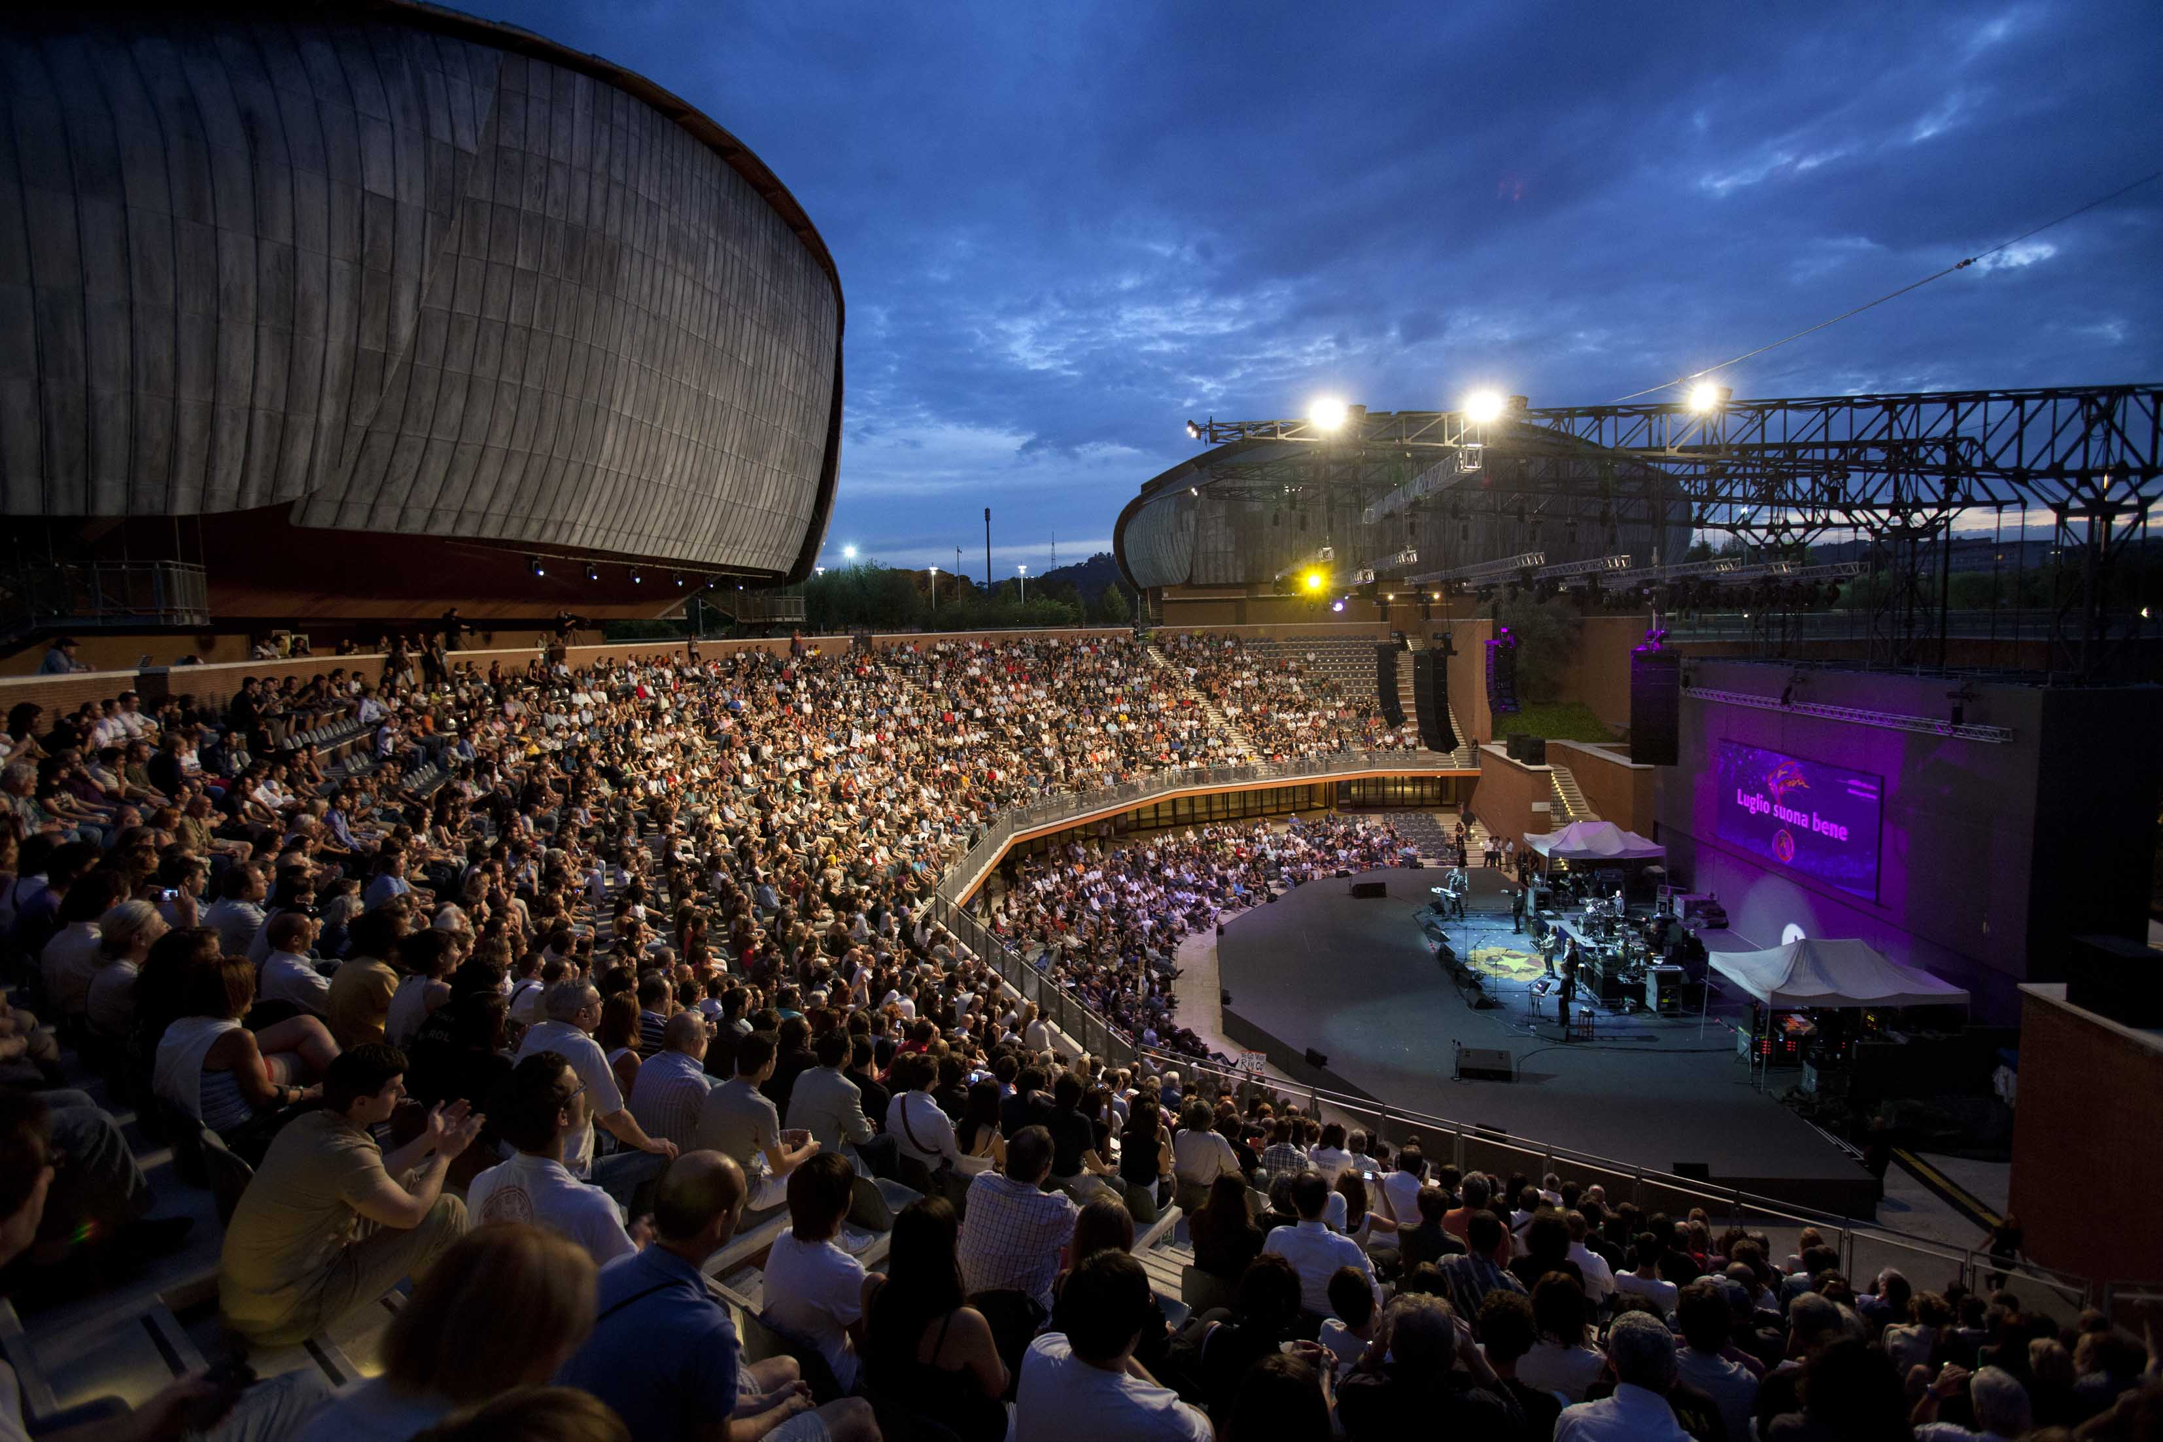
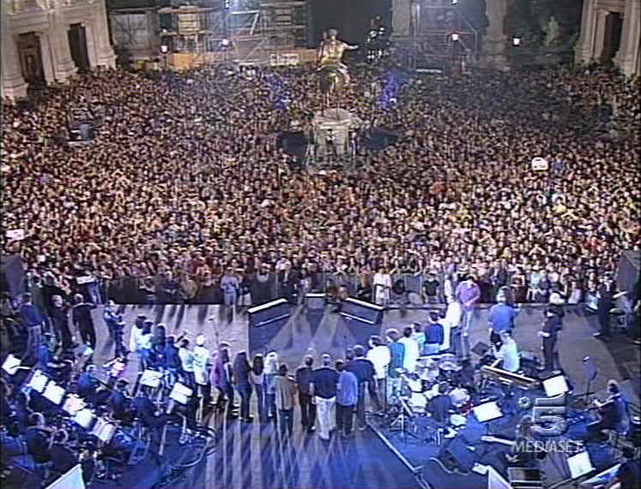
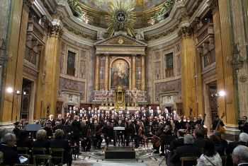
MUSIC VENUES
Balconies
Churches
Terme di Caracalla
(Baths of Caracalla)
Piazza del Campidoglio
Capitol's Square
Music is everywhere: in palaces, churches, courtyards, the ruins of Terme di Caracalla (Imperial Roman Baths), academies, oratories, concert halls, squares, villas, gardens, schools, stadiums, osterias (inns), and - in the time of coronavirus - from balconies, rooftops and windowsills of resilience

Slide 5
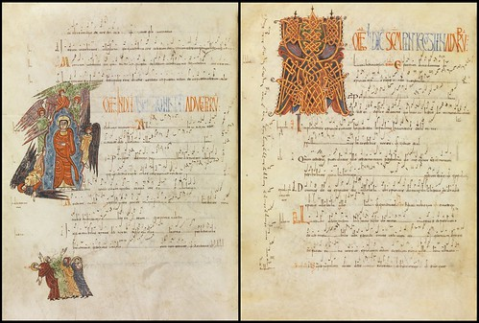
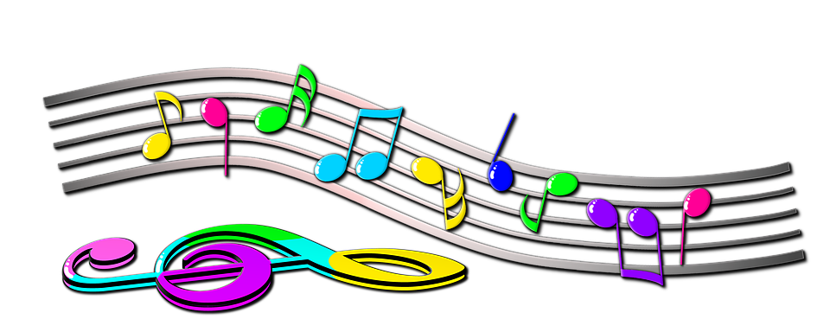
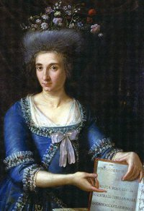
2. XVI Century: Sistine Chapel Choir
P. d Palestrina
G. Allegri
1. Middle Ages: Gregorian Chants
3. Baroque
G. Caccini
S. Landi
A. Corelli
4. XVIII Century:
Roman M.R. Coccia, aged 16. 1st woman to
get the title of Chapel
Master
5. XIX Century:
O. Respighi's dedication
To Rome
Eternal city, home to the Vatican State, seat of Roman Catholicism: Rome is devoted to religious and classical music...but not only...

Slide 6
Quanto sei
Bella Roma
L. Fiorini
Folk song
sung by
actress
A. Magnani
https://www.youtube.com/watch?v=hgnletSZhZs
Stornelli/Folk Songs
C. Villa
TRADITIONAL MUSIC :
Folk songs and Stornelli

Slide 7
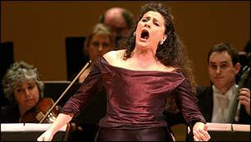
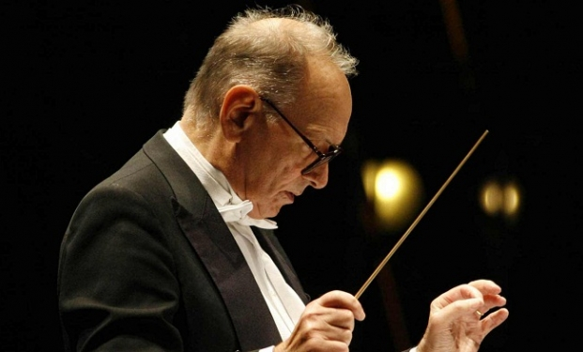
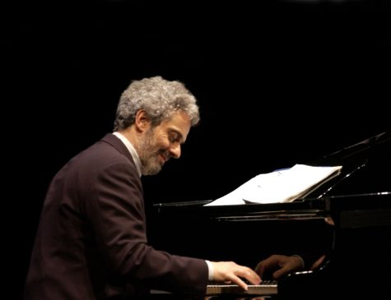
https://www.youtube.com/watch?v=X-kRgs3H7so&list=RDM9A7sqLm9Fc&index=2
Film Composers
E. Morricone
https://www.youtube.com/watch?v=oag1Dfa1e_E
N. Piovani
https://www.youtube.com/watch?v=pSmvN0FX6XU
Opera Singer
C. Bartoli
ART MUSIC

Slide 8
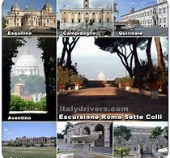
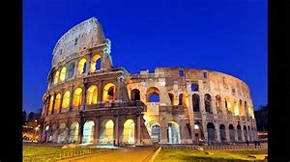
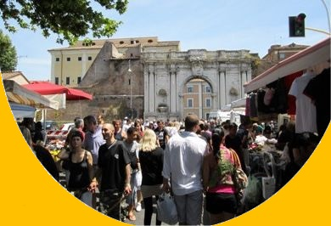
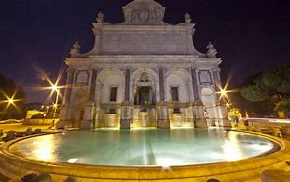
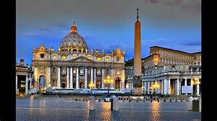
Porta Portese
C. Baglioni
Roma Capoccia
A. Venditti
https://www.youtube.com/watch?v=YZLnGNrsCYg
https://www.youtube.com/watch?v=RXxLIs49SOA
POP MUSIC DEDICATED TO ROME

Slide 9
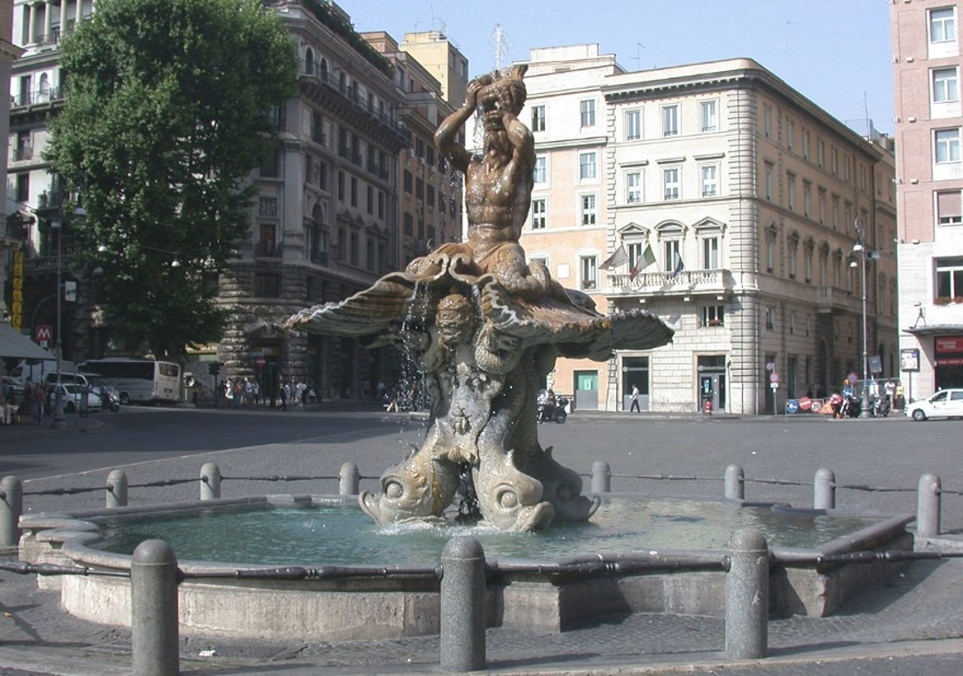
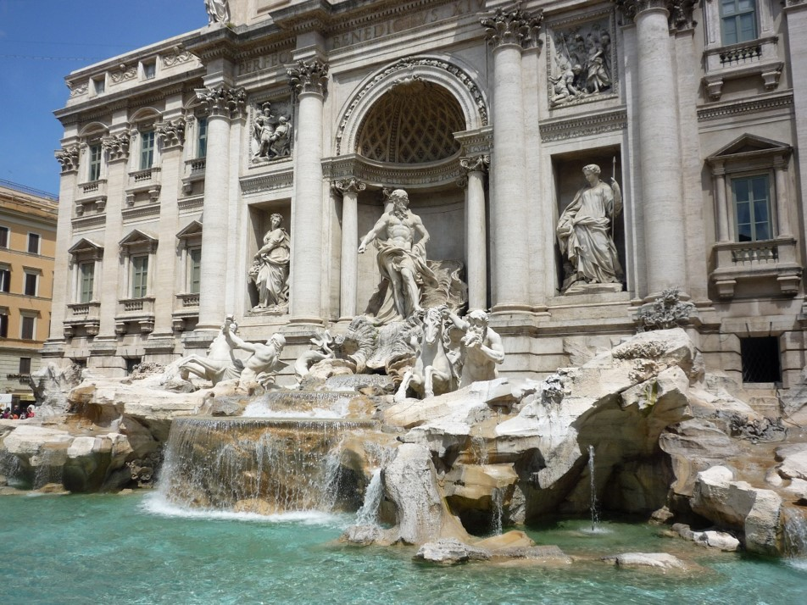
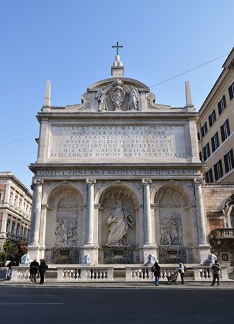
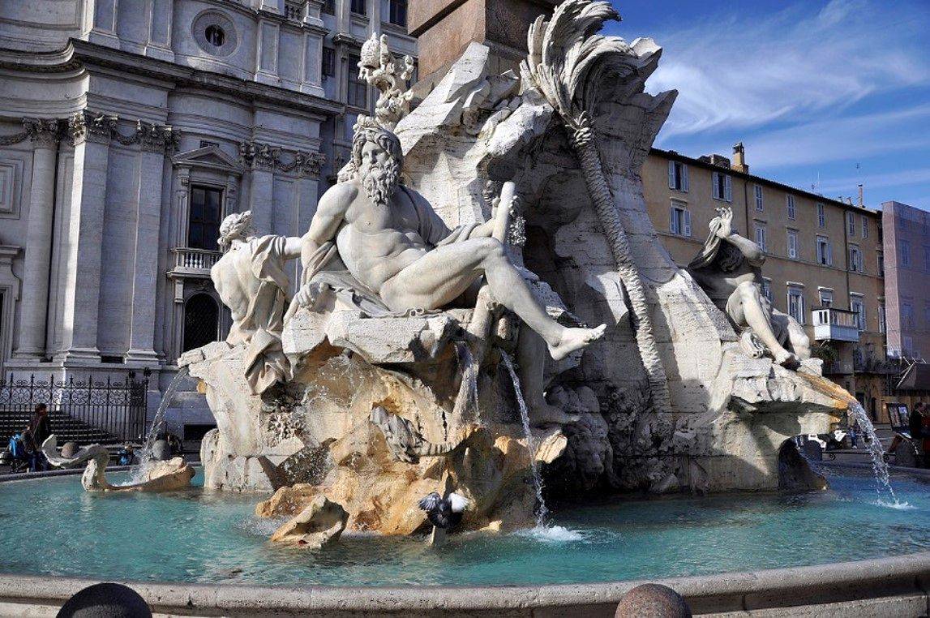
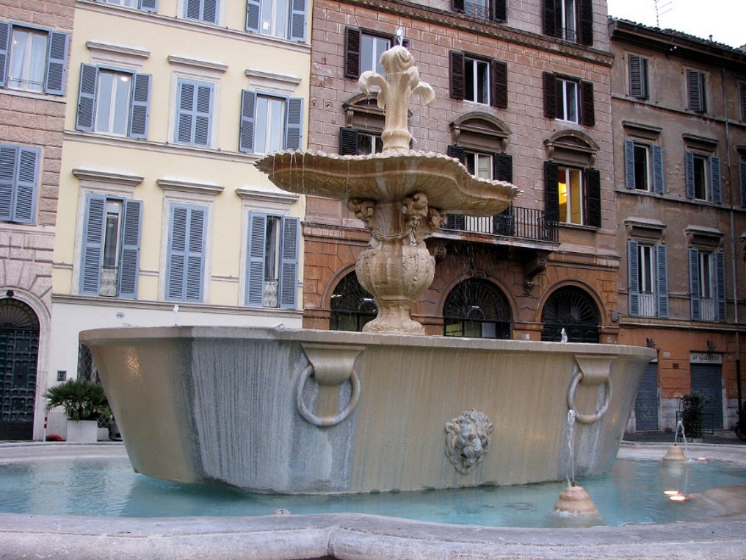
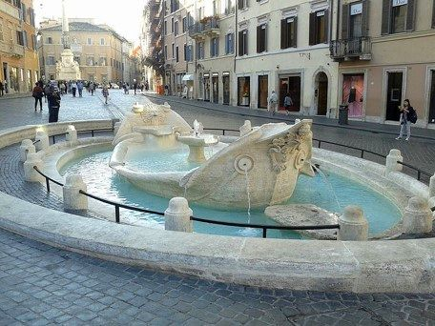
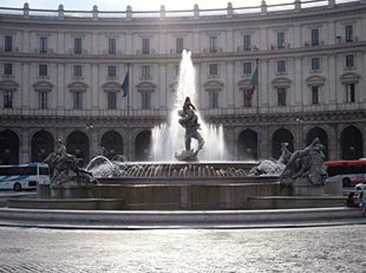
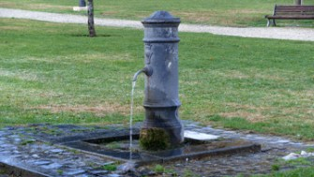
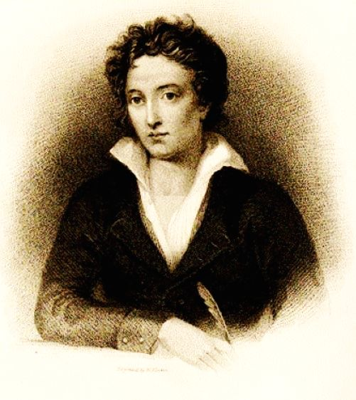
Fontana
del
Tritone
SINGING WATER
Rising and then falling water
Alternatively
Mountain's water;
Spring's water
Rain's water
Sovereign water
Water I hear
Water I cheer
Ringing water
Shining water
Singing and crying water
Laughing and moaning water
You are life and flee forever
G. D'Annunzio
Fontana
di Trevi
Fontana
del Mosè
Fontana
dei 4 fiumi
Fontana di
Piazza Farnese
Fontana
Delle
Najadi
Fontana
La Barcaccia
Nasone (fontanella):
a public fountain with drinkable water
VERY "SPECIAL" MUSIC IN ROME
"The fountains are enough to justify a trip to Rome"
P.B. Shelley

