Slide 1
“COME WITH US” eTwinning PROJECT
TOPIC 2: BUILDINGS
CLASSI TERZE- CARDINAL MASSAIA

Slide 2
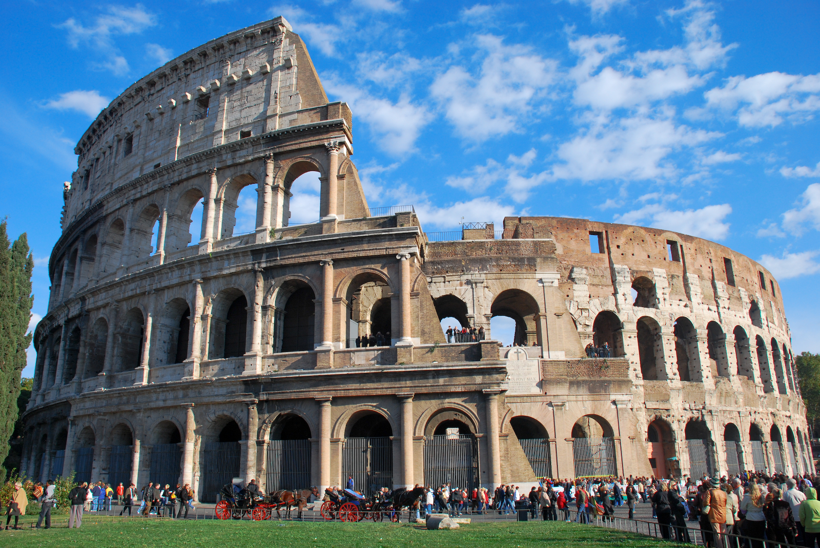
ROME: THE ETERNAL CITY
ROME IS BEST KNOWN FOR ITS ANCIENT RUINS

Slide 3
BUT DURING THE RENAISSANCE AND BAROQUE PERIOD, WONDERFUL BUILDINGS WERE BUILT.

Slide 4
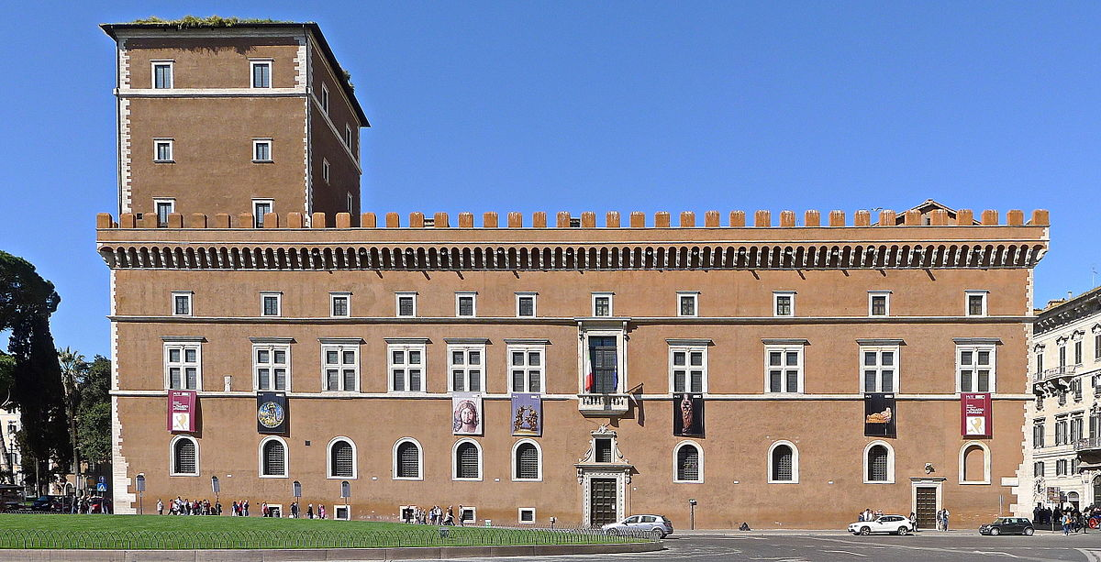
PALAZZO VENEZIA
IT IS THE HOME OF NATIONAL MUSEUM. MUSSOLINI HAD HIS OFFICE IN THIS PALACE AND USED ITS BALCONY FOR HIS SPEECHES.

Slide 5
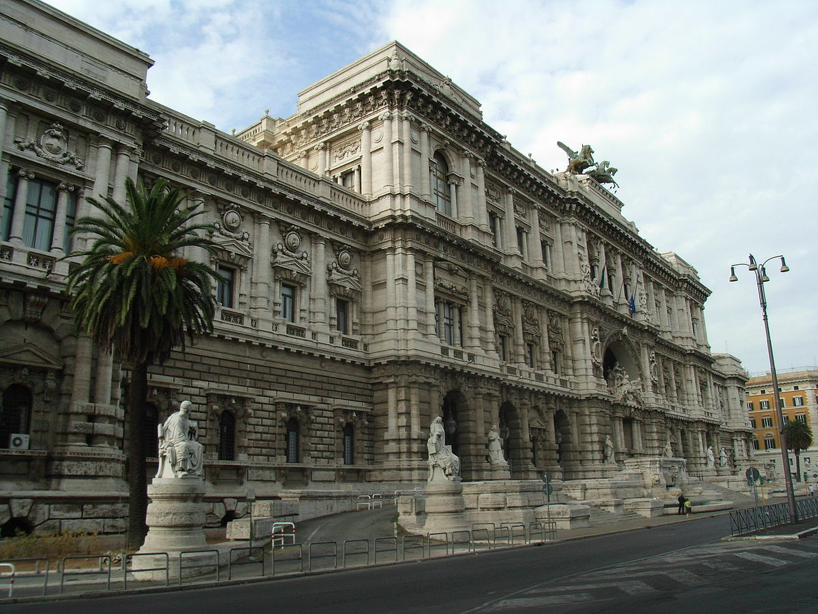
PALACE OF JUSTICE
PEOPLE OFTEN REFER TO IT AS “PALAZZACCIO” WHICH MEANS BAD PALACE BECAUSE OF ITS HUGE DIMENSIONS AND EXAGGERATED DECORATIONS.

Slide 6
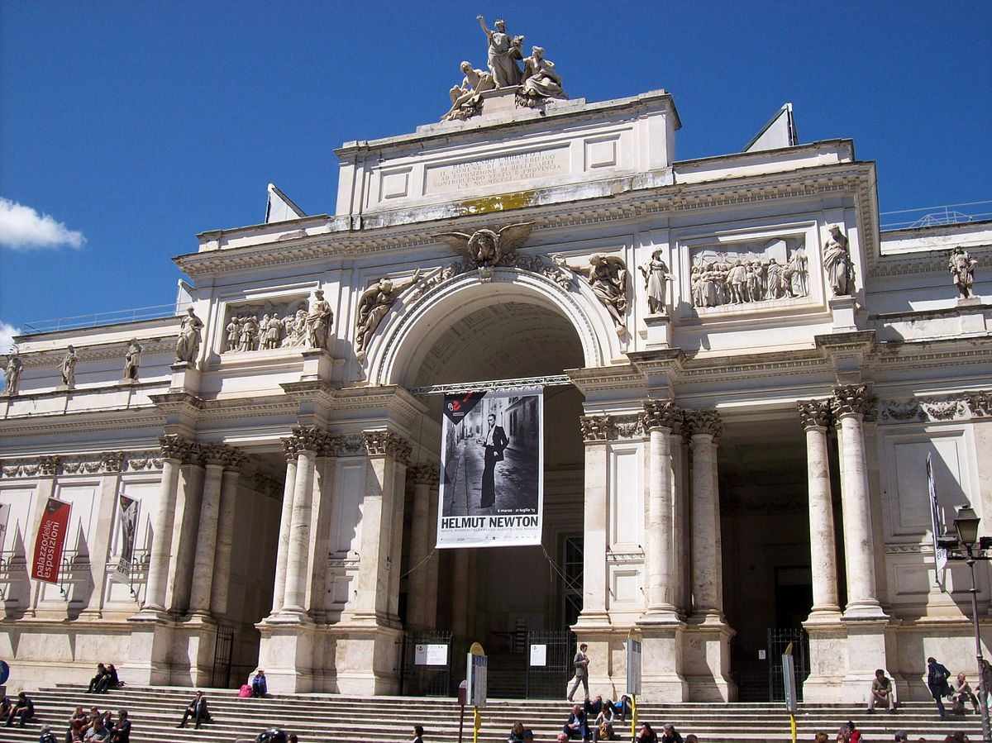
EXHIBITION PALACE
IT IS HOME OF IMPORTANT EVENTS AND ART EXHIBITIONS.

Slide 7
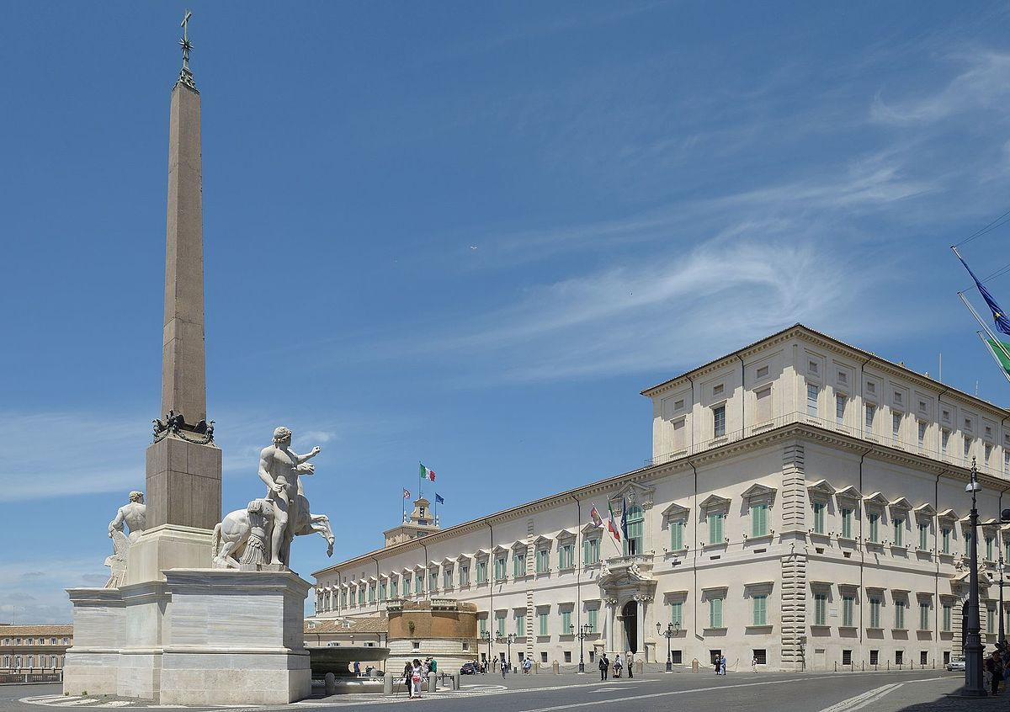
QUIRINAL PALACE
IT IS ONE OF THE SYMBOLS OF THE ITALIAN STATE. IT IS THE RESIDENCE OF THE PRESIDENT OF THE REPUBLIC.

Slide 8
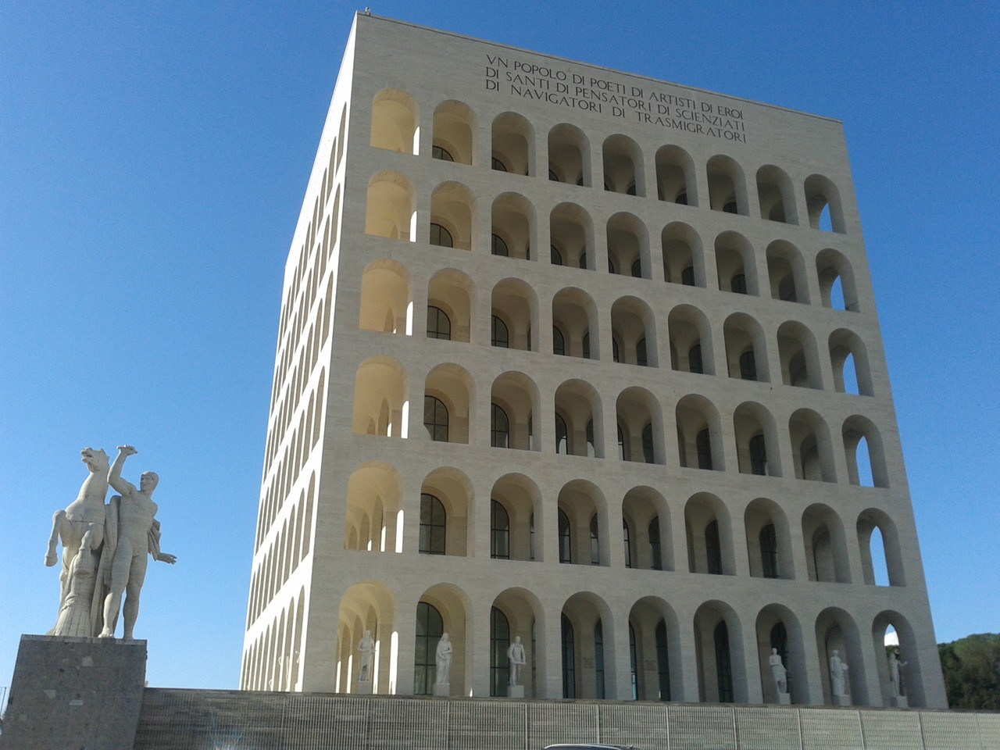
PALAZZO DELLA CIVILTA’ ITALIANA
ALSO KNOWN AS SQUARE COLOSSEUM, TODAY IT IS THE HEADQUARTERS OF FENDI.

Slide 9
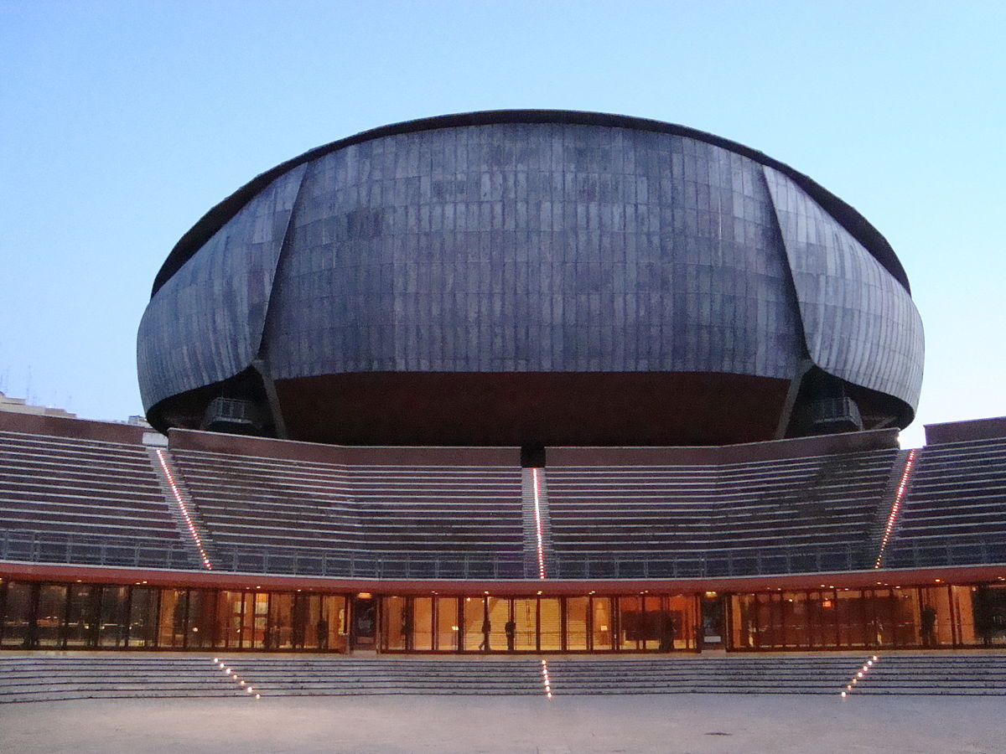
MUSIC PALACE
IT IS THE LARGEST EUROPEAN STRUCTURE DEDICATED TO THE MUSIC, PROJECTED BY ARCHITECT RENZO PIANO (2002).

Slide 10
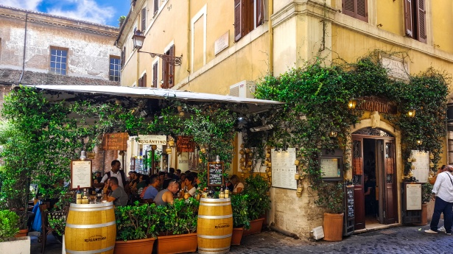
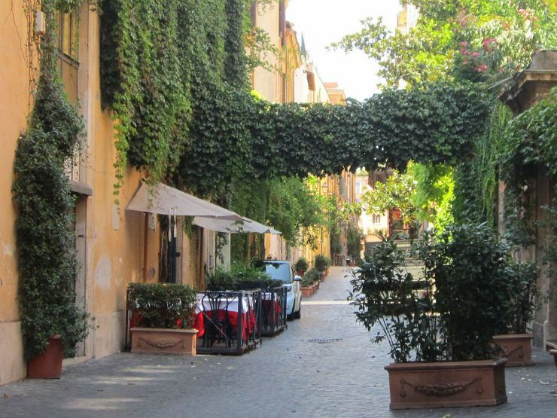
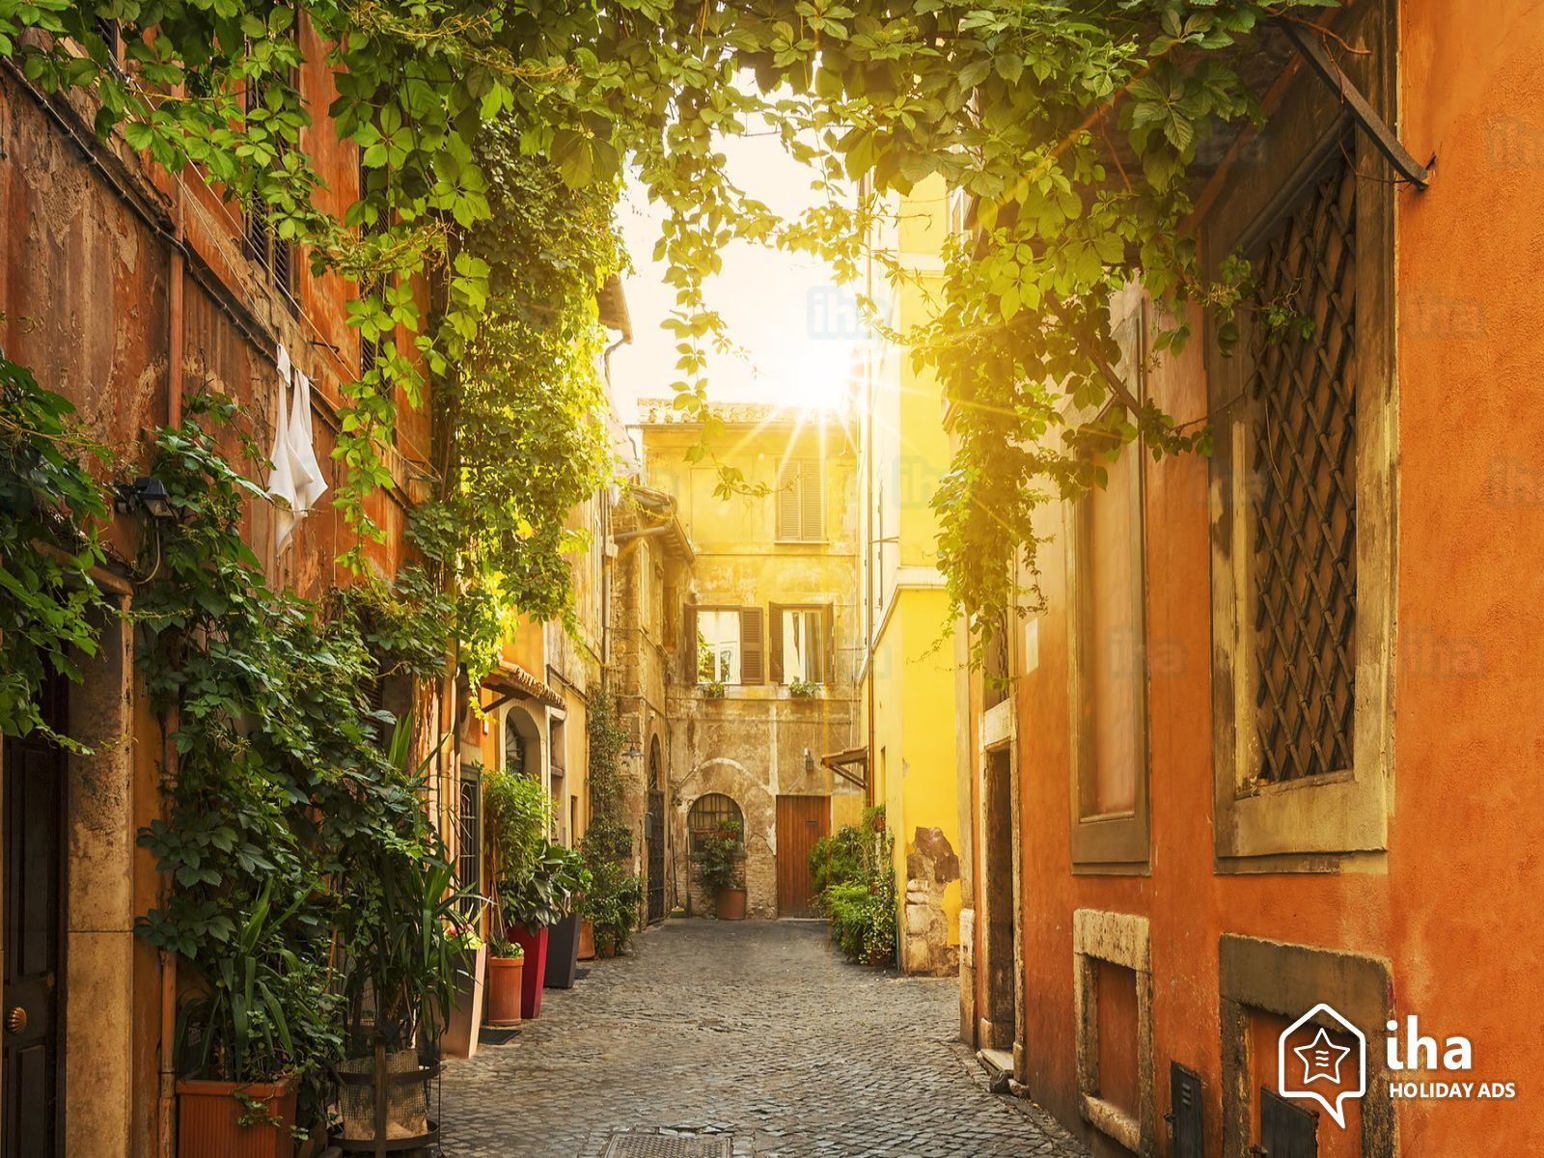
TRASTEVERE
IT IS A DISTRICT OF ROME. ITS STREETS ARE A PICTURESQUE WARREN OF OCHRE-COLORED BUILDINGS AND FLOWERS FILLED BALCONIES.

